Slide 1

Workforce Plan 2023-2028
Our Workforce Vision: A highly capable and diverse workforce with a clear understanding of our organisation's purpose and the confidence to meaningfully engage with participants and providers.
7
Senior Leaders
XXXXX
XXXXX
Final report
February 2023

Slide 2
Contents
01
02
03
Executive Summary
(page 3 - 7)
About this Plan
(pages 8 -10)
Current State View
(pages 11 - 13)
04
05
06
Future State View
(pages 14 - 20)
Delivering this Plan
(pages 21 - 33)
Appendices
(page 34-43)

Slide 3
1. Executive summary

Slide 4
The Commission’s workforce is its single greatest asset and central to achieving better outcomes for people with disability
Background
The National Disability Insurance Scheme (NDIS) Quality and Safeguards Commission (the Commission) is responsible for upholding the rights of NDIS participants, to elevate quality and safety and enable consumer independence. As the Commission transforms, the workforce is a critical enabler in achieving the future state as a contemporary, purpose-centred regulator.
Since the establishment of the Commission in 2018, there have been significant challenges in the disability sector, forcing macro-level changes to ways of working. The pandemic has altered citizen expectations, requiring public sector and disability service delivery to be adaptable. The market for talent is tight and highly competitive and the nature of work continues to change through technological, social and economic shifts, having impacts on the disability care sector, as well as the NDIS workforce. The Royal Commission into Violence, Abuse, Neglect and Exploitation of People with Disability has also placed significant focus on the regulation of quality within the scheme, meaning a Workforce Plan is critical to enabling the Commission’s ‘future state’.
Over the next five years, the Commission will be operating in an increasingly complex environment and must continue to adapt in different ways. There will be a need to focus on building on our strengths and the work we've done to date, while also refining and introducing some new skills and capabilities. We will also need to grow our workforce to meet future demand. We have the opportunity now to reflect on achievements and lessons learnt over the last four years as we reimagine the Commission and our workforce needs for the future.
Why a Workforce Plan and why now?
The Commission was first established in 2018, and its evolution has been rapid and it has had to navigate new ground as the first ever disability quality safeguarding regulator. As the Commission begins its next chapter, the need to focus on its workforce is critical. The Commission’s workforce is its single greatest asset – ‘we are passionate, purpose driven and committed to the vision of ‘One Commission’.’ The Commission’s ability to achieve its strategic priorities is reliant on a workforce that is united, capable and empowered. The Commission’s workforce is critical in building public trust in the Scheme and will be an important influencer of change across the NDIS market by building connections and collaboration across the Commission and providers, peers, participants and other NDIS stakeholders.
The Workforce Plan 2023 – 2028 (the Plan) is a priority activity in the Strategic Plan 2022-2027 and Corporate Plan 2022-23, aligned with the strategic priority of ‘Workforce Capability’. It will enable the Commission towards its vision and purpose with a clear workforce vision: A highly capable and diverse workforce with a clear understanding of our organisation’s purpose and the confidence to meaningfully engage with participants and providers. This Plan provides an important opportunity for the Commission to look at the impact of its transformation from a workforce perspective, and outline how it will invest in its people. The Plan considers key workforce investments around priority areas of growth, performance, capability, wellbeing, inclusion and diversity, identifying opportunities to respond to our emerging needs, so that the organisation is well-positioned to respond early. The Plan considers the importance of maintaining business as usual outcomes as well as supporting future workforce decision making.
Building on our strengths and the good work already underway
The Plan is designed to build and extend on the strengths of our workforce – our passion, commitment and strong belief in the Commission’s purpose. We will also leverage our people's diverse knowledge, skills and experience and their empathetic, caring, and human-centred approach to everything we do. Significant work is already underway in areas such as employee recognition, induction, onboarding and wellbeing.
The Workforce Plan is anchored in four pillars guiding our focus
The Plan includes four key, interconnected pillars: workforce sustainability, capability, growth and performance all critically enabled by diversity, inclusion and wellbeing and our culture principles. It proposes practice actions – some of which are immediate, and others medium to longer term over the coming five years.
Key Plan outcomes
A diverse workforce with the right skills and attributes that the Commission needs today and in the future to be a contemporary, purpose-centred regulator
A resilient workforce able to respond and adapt to challenges and new opportunities, giving the Commission the agility and flexibility to meet emerging needs
An employer of choice, with the ability to attract and retain people with the skills and attributes the Commission needs

Slide 5





Developing a Workforce Plan helps create the path to an engaged, skilled and sustainable workforce
Aligned to strategic priorities and initiatives already underway
Underpinned by Cultural Principles
Designed through collaboration and engagement
The Plan is a foundational first step in the workforce planning process for the Commission, and builds on existing strategies, corporate documents and initiatives such as those contained within the Strategic Plan 2022-2027 and Corporate Plan 2022-23.
At the time of development, three additional strategic initiatives were also under development – the Regulatory Approach, Operating model and the Data and Digital Roadmap. This Plan has been designed with these concurrent work streams in mind. As a flexible, living strategic document, the Plan will be reviewed as necessary to ensure ongoing alignment with the Commission’s direction.
The Plan also aligns with government and sectoral workforce priorities and initiatives, including but not limited to:
National Workforce Strategy 2022-27
Australia's Disability Strategy 2021-2031
Australian Public Service Disability Employment Strategy 2020-25,
Australian Public Service Gender Equality Strategy 2021-26,
Commonwealth Aboriginal and Torres Strait Islander Workforce Strategy 2020 -2024
Sectoral workforce strategies including the Care and Support Workforce Strategy, NDIS National Workforce Plan 2021-2025
Best practice sector and industry experience.
The Commission’s cultural principles also underpin the Plan’s success and amplify everything the Commission does. As a contemporary, purpose-centred regulator, the Commission, and Commission staff, will:
Lead the way: We communicate, anticipate and proactively respond to have a positive impact for people with disability.
Build trust: We are transparent, confident and effective in protecting the rights and safeguards of people with disability.
Keep learning: We continuously invest in our development and build our knowledge to evolve and improve.
Bring insight: We use data, technology and collaborate to identify information patterns, act early and influence the National Disability Insurance Scheme.
Stay connected: We work as One Commission, as part of the National Disability Insurance Scheme to learn, influence and adapt for regulatory impact.
The Commission remains committed to creating ongoing opportunities for the workforce to contribute and have a voice in the design and delivery of strategic initiatives.
As a result, development of this Plan has been a collaborative process. Stakeholder perspectives and insights were gathered through interviews and workshops with the Executive, Senior Leadership team and the broader workforce.
Throughout stakeholder engagement, the tone and depth of conversation was underpinned by a strong sense of shared purpose and constructive collaboration. To support collaborative delivery, ongoing consultation will continue into the future.
8
10
Weekly stand-ups
Stakeholder Interviews
9
70+
2
3
Collaborative Workshops
Team members consulted

Slide 6
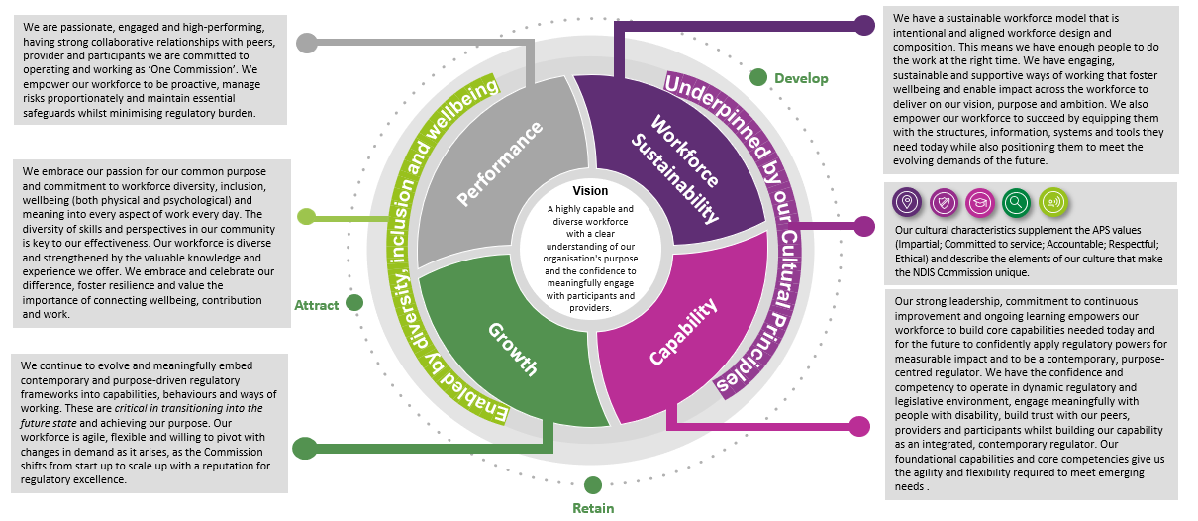
This Workforce Plan contains interconnected pillars, designed to create a more engaged, skilled and sustainable workforce
The Commission continues to build on the core strengths of our people including:
In discussions with staff and leaders it also became apparent that enabling the workforce to have a fulfilling career, feel connected to community and a sense of pride and meaningful impact toward a cause are clear motivators for the workforce. Together with our core strengths, these represent a key differentiator and central value proposition for the Commission to harness and celebrate into the future.
This Plan identifies areas for investment that will assist the Commission as the operating environment continues to evolve, and as the Commission matures as an organisation. This will support the Commission as it continues on the journey from start-up to scale-up and in turn, contribute toward meeting the needs of our community and of Government. See section 3 for current state view and section 4 for detailed opportunities for investment. The opportunities for investment are categorised into five workforce pillars. Each pillar has been defined, and a range of strategies have been developed to address risks (see sections 4-5 for all pillars and strategies).
Introducing the Workforce Plan pillars
We are passionate and committed with a strong belief in our purpose
We bring diverse knowledge, experience and expertise in working in disability and related sectors
We show empathy and care in working with participants, providers and the disability sector
(See sections 4-5 for all pillars and strategies)
The Commission needs: a sustainable workforce approach that enables collaboration; to invest in developing the right capabilities and providing growth for its people; to empower its people to be high performing; and to invest in how it delivers on its vision for a diverse, inclusive and healthy workforce.

Slide 7
There are some opportunities that can be pursued early that will contribute to the Commission’s longer term success
A high-level opportunity roadmap containing 40 opportunities
With 5 foundational opportunities identified as priority recommendations
To realise the Commission’s workforce vision, achieve its strategic priorities and address workforce risks and opportunities, this Plan identifies a number of data-informed priority opportunities to guide how the Commission attracts, develops and retains a diverse workforce with the right skills and attributes over the coming five years. 40 opportunities have been identified and have been prioritised into three horizons (0 - 6 months, 6 – 18 months, 18 months+). While all opportunities are recognised as important, high-level prioritisation has been undertaken to also consider the value that the opportunity will bring, the ease at which it can be implemented and associated interdependencies and sequencing, the building maturity and sophistication to fully realise the benefits of the opportunity. Some key pieces of work are already underway. Some examples include areas such as employee recognition, induction and onboarding, leadership development, organisational capability analysis, and the development of a wellbeing program. It is important to note, this Plan isn’t an endorsed suite of recommendations or agreed program of work. The recommended opportunities will require further validation and decision making based on organisational priorities, capacity and available funding including endorsement by the ELT. In practice, this means initiatives may not commence immediately and ongoing engagement with key stakeholders will be critical to striking the balance between maintaining momentum and required governance processes.
To initiate the implementation across the workforce pillars, 5 priority recommendations have been identified (below). These recommendations are imperative to creating a foundation for future opportunities the Commission may want to undertake. These recommendations are considered ‘no-regrets’ investments, that are low risk decisions the Commission can make to respond to immediate priorities. Each recommendation can also be undertaken in incremental steps, initially through a ‘zero investment’ lens – exploring innovative ways to redirect and reprioritise effort including but not limited to exploring opportunities to draw on the incoming capability, capacity and perspectives of new starters joining the Commission.
For more detail see Section 4 (Future State View) and Section 5 (Delivering the Plan).

Slide 8
2. About this Plan

Slide 9
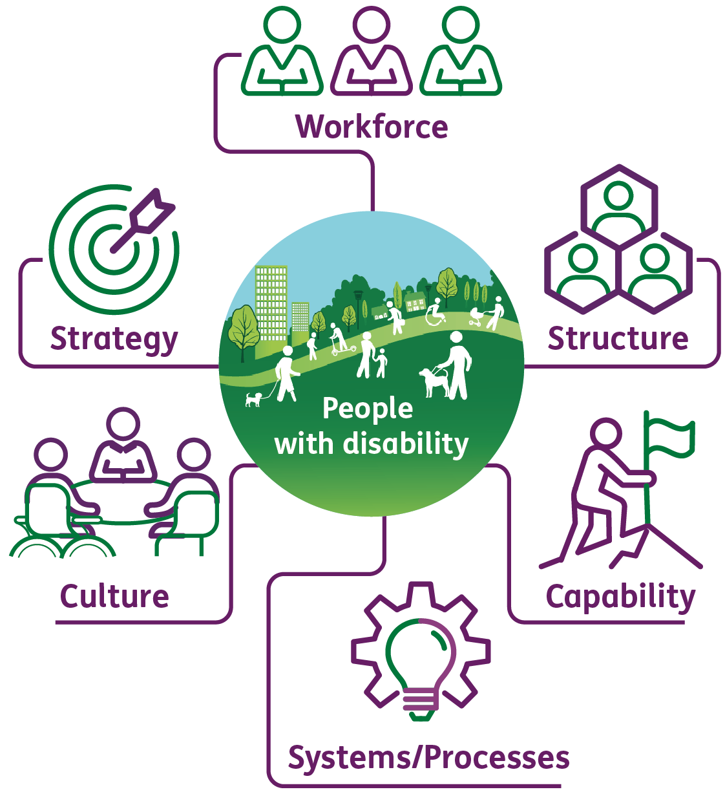





Developing a Workforce Plan creates the path to a more engaged, skilled and sustainable workforce
Audience of this Plan
Scope
Alignment to our existing strategic priorities
The Commission’s people are its greatest asset, this Workforce Plan has been designed to benefit all staff across the Commission. The strategy provides a clear line of sight between strategic priorities and how the Commission attracts, develops and retains a diverse workforce with the necessary capability and attributes needed to respond to challenges as they arise and effectively achieve our purpose; upholding the rights of NDIS participants. While this document is for internal Commission use, it has been designed with various perspectives in mind, including that of our current workforce – both workers and leaders at all levels, as well as our future workforce, our future pipeline of talent and participants and providers.
This Plan provides the opportunity for the Commission to look at the impact of its transformation from a workforce capability perspective. The Plan operates as a visioning document to help identify future workforce needs and identify potential workforce gaps, so that the organisation is well-positioned to respond early.
In devising this Plan, the team considered:
a current state workforce view incorporating analysis of macro, external drivers of change as well as internal risks and opportunities that may impact current and future workforce decisions (Section 3)
a future state workforce view designed around four, core workforce plan pillars – Workforce Sustainability, Capability, Growth and Performance. The pillars are enabled by Diversity, Inclusion and Wellbeing and underpinned by our Cultural Principles which are at the heart of everything the Commission does. Each pillar describes our future state workforce aspiration, what this looks like in practice and a range of workforce opportunities to help get us there (Section 4)
a proposed high-level implementation roadmap, prioritising workforce opportunities the Commission may pursue over a five year horizon. These will require further validation and decision making based on organisational priorities, capacity and available funding and is not an endorsed suite of recommendations or agreed program of work nor is it intended to identify organisational structure related changes (Section 5)
The strategic plan identified that the Commission is building a Workforce Plan to develop, attract and retain a diverse mix of the right staff with the right skills and attributes. This Plan is a foundational step in the workforce planning process for the Commission, and builds on corporate documents such as Strategic Plan 2022-2027, Corporate Plan 2022-27 and Our Future State operating model work.
Recommended review
Our People
I can see a clear and practical line of sight between our strategic priorities and vision, and our Workforce Plan. I understand the capability and cultural changes needed, the opportunities ahead and how I can proactively contribute to our success in the next five years.
This document is intended to be iterative, refined as new information and insights arise and to remain aligned with the operating environment.
Data related assumptions
Our Leaders
As a leader, I can see a clear and practical line of sight between our strategic priorities, vision and our Workforce Plan. I understand the critical role I play as a leader in taking the Commission forward and feel empowered to purposefully lead, develop and support others.
In developing this report, multiple workforce data sources have been used to gather quantitative insights. Through this process a number of data limitations arose, impacting the depth od analysis possible including in relation to commencement, tenure, workforce segment and recruitment data. To supplement the quantitative data, interviews with senior stakeholders were undertaken. All data is current as at 30 June 2022.
9

Slide 10



This Plan builds on the existing strengths of our workforce and the work already underway across the Commission
We are passionate and committed with a strong belief in our purpose
We bring diverse knowledge, expertise and experience working in disability and related sectors
We show empathy and care in working with participants, providers and the disability sector
Our workforce individually and collectively has a strong belief in the Commission’s purpose and vision. The workforce is deeply committed and passionate about enabling people with disability to achieve their aspirations by keeping people with disability at the heart of what we do and every decision we make. Day to day, this means that we regularly go above and beyond in trying to meet the needs of participants and working with service providers.
Our workforce joined the Commission to be a part of our important work, bringing diverse experience and knowledge across the disability and related sectors. The Commission has the ability to tap into and access the collective workforce knowledge, skills and experience across the sector ecosystem. We must continue to foster, harness and diversify this experience within the regulatory context.
Showing empathy and care is in our DNA. We celebrate and draw upon our lived experiences, knowledge and passion to deliver quality consumer experiences everyday. We aim to always deliver positive experiences to participants, providers and colleagues across all roles and functions whether it be customer service, complaints, registrations or investigations.
In discussions with staff and leaders it was apparent that a fulfilling career, feeling connected to community and a having a sense of pride and meaningful impact toward a cause are clear motivators for the workforce. Together, with our core strengths, these represent a key differentiator and central value proposition for the Commission to continue harnessing and celebrating into the future.
Throughout this Plan you will find references to the workforce strength icons shown here, linking our work to our people.
We already have work underway in areas such as employee recognition, induction and onboarding, leadership development, organisational capability analysis and wellbeing through existing initiatives and working groups.
Existing workforce initiatives contained within the Strategic Plan 2022-2027, Corporate Plan 2022-2027 and Staff feedback to the Commissioner such as a Rewards and Recognition Awards Program and Induction Program.
Employee Census Working Group to drive activity and future actions arising out of the recent APS Census
Strategic Initiatives Oversight (SIO) Group to drive cross-functional clarity across three strategic engagements* that will operationalise the strategic ambition of the Commission
* Regulatory Approach and Operating Model, Data and Digital Roadmap and Workforce Plan

Slide 11
3. Current State View

Slide 12


The Commission’s context is changing which has implications for current and future workforce decisions
External drivers of change
The COVID-19 pandemic exacerbated operating challenges across all sectors, with the care and support sector particularly affected. The pandemic has had far reaching impacts in how the Commission manages and interacts with its workforce as well as its partners, providers and participants. The pandemic accelerated change for businesses and workers alike, with new ways of working being adopted and an increase in the use of digital technology, automation and artificial intelligence. As the endemic continues and becomes a more recognisable part of daily life, a new normal is being redefined across society and in the workplace. Managing the balancing act of the new hybrid work era, ongoing investment in digital technology and capability as well as an increasing focus on the general health and well-being of the workforce continues to be a core focus.
The level of national awareness and maturity across the disability sector and the NDIS has evolved rapidly in the last five years. This is alongside the increase in demand for services, and changing consumer preferences. It is estimated that the number of NDIS participants will increase by 84% by 2030¹. Together these challenges have exacerbated workforce shortages within the disability sector and challenged the way in which the Commission collaborates with participants and providers. The Royal Commission into Violence, Abuse, Neglect and Exploitation of People with Disability has put significant focus on the regulation of quality within the scheme, meaning a workforce strategy is critical to enabling the Commission’s ‘future state’.
The Future of Work is changing the way that people want to engage with their employers and how work is conducted is fundamentally being challenged. There has been a shift in employee expectations around ways of working; with working preferences evolving from traditional office based environments to remote and hybrid ways of working becoming the new normal. Connectivity in and across the physical and digital workplaces requires significant transformation for all organisations to ensure fairness and equality in the workplace.
Labour supply and skills shortages continue in a highly competitive, and tight labour market. The war for talent and skills remains very real, there are currently 470,000 job vacancies across Australia, and of those 45,000 are vacancies within the public sector². Organisations that are open to change and view their digital workspace as an extension of the physical workplace, are attracting talent and have better access to labour markets outside of capital cities.
Australia is experiencing a tight fiscal environment with substantial pressure on inflation and interest rates as part of the post pandemic recovery. A focus on budget repair and quality spending is expected to continue.
New and emerging technologies are rapidly redefining how we interact and collaborate with our stakeholders, the workplace and each other. Society is an ever increasing digitally enabled and connected place. Consumer expectations and preferences are also rapid changing. Personalised, digitally enabled, multi-channel service offerings that can happen anytime-anywhere is also the ‘new norm’. Capability and mindset shifts will be key alongside advancing technology.
Public trust levels are declining and there is an increasing focus on how to engage with the community in design and delivery of public policy. The 2022 Edelman Trust Barometer also reveals sharp declines in trust across all Australian institutions, eroding the record-high levels of public trust recorded in 2021. Only 52% of Australians say they trust government to do the right thing (-9 points year-on-year) and 58% trusting each business (-5 points) and NGOs (-4 points)³. Rebuilding trust and trustworthy perceptions with community requires designing and delivering the customer experience with trust in mind. The review of the NDIS has been brought forward to restore trust with participants against a backdrop of an announcement that the scheme will cost $8.8 billion more over the next four years than previously forecast.
Source: 1 NDIS Annual Financial Sustainability Report 2020-21 | 2 ABS Job Vacancies, Australia Sep 2022 | 3 https://www.edelman.com.au/trust-barometer-2022-australia

Slide 13
Skills and capabilities specifically required by the Commission are likely to remain in high demand
Continuing to build and access diverse talent pipelines
Labour market scan
Continuing to build and access diverse talent pipelines will be critical to meeting demand and providing high-quality outcomes for participants and providers.
As the Commission transitions from start-up to scale-up, it will need to understand the current and future state workforce, the skills and capabilities needed and the challenges it faces. The Commission faces workforce supply challenges of a tight and highly competitive labour market. The opportunity to access new and different labour markets together with existing talent pipelines will enable the Commission to contribute to Australia’s overall economic recovery and ensuring that all Australians receive the care they need and deserve.
Equally, as the demand for disability care services continues to grow, so too will the demand for regulatory services from the Commission.
One in seven workers are now employed in healthcare or social services. In the decade to August 2021, the health and community services workforce grew by 50 per cent — almost 600,000 extra employees¹
Across disability care the estimated shortage of NDIS workers last year alone was 120,000 ²
There are currently 10,000 people employed in regulatory services, within Public Administration and Safety industry. The industry has a projected employment growth of 6.4% over the next five years³.
For the Commission this means investing in early career programs, tapping into adjacent sectors, existing APS diversity employment programs and reimagining the geographic footprint. This could also include; exploring secondment and transition to retirement programs, as well as; hiring for potential not only experience and proven capability. These opportunities will all assist in building the Commission’s talent pipeline for the future. This together with ongoing monitoring of labour market changes, will ensure the Commission is equipped to respond to economic changes and also build and acquire the skills needed most.
Occupation​ | Employment predictions ​(FY21 to FY26) | Average Age​ (yrs) | % in PAS* | Future Growth | NSW candidate %
Contact and Call Centre Workers ​ | 33,600 to 33,800 | 34 | 20.8%​ | +0.7%​ | 29.6​
Contract, Program, Project Admin ​ | 127,800 to 139,700 | 42 | 27.3%​ | +9.3%​ | 30.3%​
Health and Welfare Service Managers ​ | 35,800 to 45,300 | 48 | 9.3%​ | +26.5%​ | 33.4%​
Inspectors, Regulatory Officers ​ | 44,200 to 49,500 | 44 | 68%​ | +11.8%​ | 30.9%​
Judicial and Legal Professionals ​ | 12,400 to 13,800 ​ | 45 | 49.5% | +11%​ | 30.9%​
Information Officer | 59,600 to 61,400 | 39 | 23.6% | +3% | 33.6%
Intelligence and Policy Analyst | 28,500 to 31,000 | 38 | 77.4% | +8.7% | 20.5%
Policy Analyst | 13,300 | 38 | 79.8% | N/A | 20.5%
Policy and Planning Manager | 26,400 to 28,000 | 44 | 52.5% | +5.7% | 27.9%
Community Worker | 24,400 | 45 | 17.3% | N/A | 29.4%
Occupation spotlight – tapping into adjacent sectors and roles
Strategy and Policy – Policy Analyst
Investigations – Intelligence and Policy Analysts
Liaises and consults with program administrators and other interested parties to identify policy needs
Reviews existing policies and legislation
Researches social, economic and industrial trends, and client expectations of programs and services provided
Formulates and analyses policy options, prepares briefing papers and recommendations for policy changes, advises on options
Assesses impacts, financial implications, interactions with other programs and political and administrative feasibility of policies
Determining organisational and client intelligence requirements
Organising, collecting, collating and analysing data, and developing intelligence information such as electronic surveillance
Compiling and disseminating intelligence information using briefings, maps, charts, reports and other methods
Ascertaining the accuracy of data collected and reliability of sources
Conducting threat and risk assessments and developing responses
These roles are geographically dispersed across the country consistent with your footprint.
(See Appendix C)
Source: 1 2021 ABS Census Second Release – October 2022 | 2 PwC Care Sector Report – The halo effect: Reimagining Australia's care workforce – September 2022 | 3 National Skills Commission, Labour market insights - 2022; *PAS - Public Administration and Safety

Slide 14
4. Future State View

Slide 15
Our Workforce Plan contains interconnected pillars, designed to create a more engaged, skilled and sustainable workforce
Strengths detailed on slide 10
We are passionate, engaged and high-performing, having strong collaborative relationships with peers, providers and participants. We are committed to operating and working as ‘One Commission’. We empower our workforce to be proactive, manage risks proportionately and maintain essential safeguards whilst minimising regulatory burden.
We have a sustainable workforce model that is intentional and aligned to our workforce design and composition. This means we have enough people to do the work at the right time. We have engaging, sustainable and supportive ways of working that foster wellbeing and enable impact across the workforce to deliver on our vision, purpose and ambition. We empower our workforce to succeed by equipping them with the structures, information, systems and tools they need today while also positioning them to meet the evolving demands of the future.
Develop
Enabled by diversity, inclusion and wellbeing
Underpinned by our Cultural Principles
We embrace our passion for our common purpose and demonstrate commitment to workforce diversity, inclusion, wellbeing (both physical and psychological) and meaning in every aspect of work every day. The diversity of skills and perspectives in our community is key to our effectiveness. Our workforce is diverse and strengthened by the valuable knowledge and experience we offer. We embrace and celebrate our difference, foster resilience and value the importance of connecting wellbeing, contribution and work.
Performance
Workforce Sustainability
Vision
A highly capable and diverse workforce with a clear understanding of our organisation's purpose and the confidence to meaningfully engage with participants and providers.
Our cultural characteristics supplement the APS values (Impartial; Committed to service; Accountable; Respectful; Ethical) and describe the elements of our culture that make the NDIS Commission unique.
Attract
Capability
Our strong leadership, commitment to continuous improvement and ongoing learning empowers our workforce to build core capabilities needed today and for the future to confidently apply regulatory powers for measurable impact and to be a contemporary, purpose-centred regulator. We have the confidence and competency to operate in dynamic regulatory and legislative environment, engage meaningfully with people with disability, build trust with our peers, providers and participants whilst building our capability as an integrated, contemporary regulator. Our foundational capabilities and core competencies give us the agility and flexibility required to meet emerging needs .
We continue to evolve and meaningfully embed contemporary and purpose-driven regulatory frameworks into capabilities, behaviours and ways of working. These are critical in transitioning into the future state and achieving our purpose. Our workforce is agile, flexible and willing to pivot with changes in demand as it arises, as the Commission shifts from start-up to scale-up with a reputation for regulatory excellence.
Growth
Retain
The Commission needs: a sustainable workforce approach that enables collaboration; to invest in developing the right capabilities and providing growth for its people; to empower its people to be high performing; and to invest in how it delivers on its vision for a diverse, inclusive and healthy workforce.

Slide 16
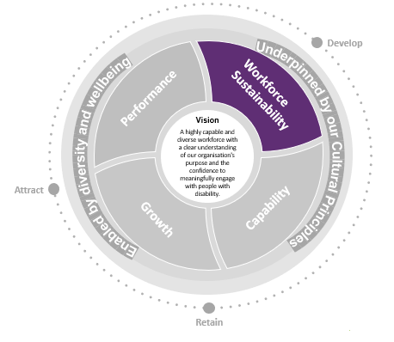






Pillar: Workforce Sustainability
Our Aspiration
We have a sustainable workforce model that is intentional and aligned to our workforce design and composition. This means we have enough people to do the work at the right time. We have engaging, sustainable and supportive ways of working that foster wellbeing and enable impact across the workforce to deliver on our vision, purpose and ambition.
We also empower our workforce to succeed by equipping them with the structures, information, systems and tools they need today while also positioning them to meet the evolving demands of the future.
We do this by:
having a purposeful Employee Value Proposition highlighting the experience and value of working in the Commission and what this means and looks like for current and future workers
building sustainable workforces through talent planning and flexible delivery including growing the pipeline of skilled workforce to meet the increasing demand as well as accessing a skilled and ready contingent workforce when needed
collaborating and creating connections using our internal networks, active cross teams and cross leadership planning and delivering, breaking down silos
alignment on our purpose through clearly defined roles, responsibilities and accountabilities that align to our purpose and link to the organisational strategy
being informed by data and digitally driven solutions -- leveraging data, gathering intelligence and digital technology to support those we regulate to comply and grow. This includes ensuring we have the right tools to support the important work we do
Outcomes
Strengths detailed on slide 10
Practically success looks like …
Attract, recruit and retain a diverse workforce in a highly competitive market, to meet increasing demand (capacity), recruiting talent from different markets with the skills (capability) we need to uphold the rights of NDIS participants, elevate quality and safety and enable consumer independence
A streamlined and unifying experience including building knowledge, understanding and expectations of the ‘One Commission’ approach in practice
A shared understanding of what other people and teams do, and when to connect and collaborate with them in order to achieve the best outcomes
Enhanced workforce mobility, flexibility and agility across teams and roles in the Commission over time
Increased capacity of the existing workforce through process optimisation, automation and continuous improvement
“As a new staff member, I understand and feel connected to the work the Commission does and how I could practically contribute in a number of different teams, bringing my skills and experience and adapting to the ‘One Commission’ context.”
+Icon
“While my role is in XXX, I proactively reach out into other areas for the aspects of my work that intersect with other work areas to proactively collaborate and support the consumer experience of those we engage with.”
+Icon
+Icon
“As a leader, I have access to a flexible workforce with the skills needed to assist in managing surges in workload.”

Slide 17
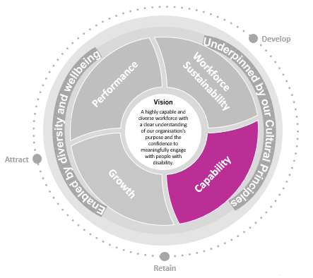






Pillar: Capability
Our Aspiration
Our strong leadership, commitment to continuous improvement and ongoing learning empowers our workforce to build core capabilities needed today and for the future to confidently apply regulatory powers for measurable impact and to be a contemporary, purpose-centred regulator.
We have the confidence and competency to operate in dynamic regulatory and legislative environment, engage meaningfully with people with disability, build trust with our peers, providers and participants whilst building our capability as an integrated, contemporary regulator. Our foundational capabilities and core competencies give us the agility and flexibility required to meet emerging needs
We do this by:
Strengthening our technical capability by providing the workforce with the opportunities, capability, data, technology, systems and support to empower them to manage risks proportionately and maintain essential safeguards while minimising regulatory burden. At the heart this requires upskilling in relation to risk and regulatory practices in the Commission
Ensuring that all our people have access to grow and develop foundational and core competencies as well as develop in their area of expertise
Attracting and developing strong leadership capability
Strengthening career pathways and mobility and embracing our workforce potential across functions and groups, investing in the skills and career pathways of our workforce to improve retention
Investing in upskilling our people to ensure the most up-to-date industry and regulatory knowledge is available and the workforce is empowered and capable to apply regulatory powers with people with disability at the centre
Enabling our people to drive their own career that aligns to their interests
Outcomes
Strengths detailed on slide 10
Practically success sounds like …
A ‘One Commission’ core capability set, that enables the Commission to attract, recruit, develop and retain a flexible and agile workforce
Enhanced workforce capability and mobility across roles and teams in the Commission
Confident and empowered leadership team with the capability to manage team development and performance
Attract, recruit and retain a diverse group of job seekers to meet both an increase in demand and changing stakeholder expectations, targeting talent from different segments of the labour market with a mix of capabilities and experiences.
“Although my title may be XX, or XX, I understand that at the heart of it, we are all Regulatory Officers and have a key role supporting a One Commission Approach.”
“While I work in XX area today, I understand how my core skills are transferable to work done in XX, XX or XX and I have the capability and confidence to work flexibly where I am needed.”
“I recently had the opportunity to intern with the XX team as a university student. I learnt so much from the experience and hope to join the Commission as a Graduate.

Slide 18
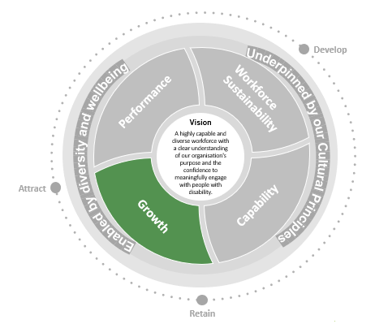






Pillar: Growth
Outcomes
Strengths detailed on slide 10
Our Aspiration
We continue to evolve and meaningfully embed contemporary and purpose-driven regulatory frameworks into capabilities, behaviours and ways of working. These are critical in transitioning into the future state and achieving our purpose. Our workforce is agile, flexible and willing to pivot with changes in demand as it arises, as the Commission shifts from start-up to scale-up with a reputation for regulatory excellence.
We do this by:
leveraging capacity within the workforce, by building internal capability and cross skilling our people so they can flex and respond to increases in demand as it arises
continuing to attract diverse talent to our workforce and encouraging workforce participation across different segments of the labour market
enabling our people and leaders to grow and develop through consistent and sustainable talent planning processes
prioritising work and managing risk proportionately, taking decisive, proactive action through change uncertainty
empowering continuous improvement, innovation and reflection at all levels and stages of the employee lifecycle
enabling collaboration, cooperation, engagement, communication and information sharing with our peers and partners
Practically success sounds like …
Increased representation of workers from diverse backgrounds with differing experience and skill sets
Established talent pipelines with succession plans in place across all roles
Nationally consistent approach in the ways in which the Commission collaborates, engages and operates across each state and territory
Flexible and agile workforce that can respond to demand and reprioritise workload when needed
“As a leader I have confidence that in times of peak workload or surge, I can flexibly draw on workers in other teams across the Commission who have the skills needed to get the work done”
“Today I work in XX, and thanks to our monthly all hands meeting, I have clear understanding of other functions, the work they are undertaking, how our teams are connected and who I can contact”.
“I have an ambition to grow and develop ready for a leadership role one day soon. I have had the opportunity to build the skills and experience I need to be ready for my career path, including shadowing, leading projects and supporting team development.”

Slide 19
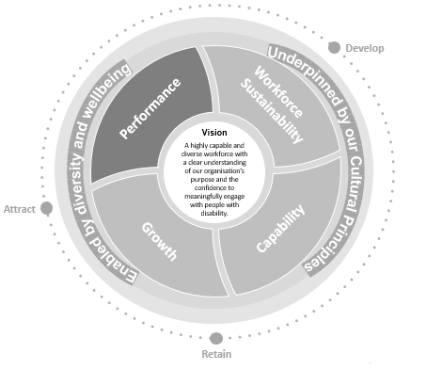




Pillar: Performance
Our Aspiration
We are passionate, engaged and high-performing, having strong collaborative relationships with peers, providers and participants and we are committed to operating and working as ‘One Commission’.
We empower our workforce to be proactive, manage risks proportionately and maintain essential safeguards whilst minimising regulatory burden.
We do this by:
clearly defining roles, responsibilities and goals that align to our strategic objectives
establishing engaging performance and development planning processes that nurture and grow talent
empowering our leaders to role model desired leadership skills, knowledge, attitudes and behaviours
equipping our leaders with the tools and guides enabling them to manage performance and develop their people consistently
creating a shared understanding and connection of how everyone contributes to our vision, purpose and ambition
recognising our people and acknowledging their positive contribution across our cultural principles and workforce pillars
being proactive and showing initiative, focusing on continuous improvement and action orientation
Outcomes
Practically success sounds like …
Our leaders are capable, confident and feel empowered to lead and develop their people and teams across all levels
Enhanced and consistent approach to performance management with Professional Development Plans in place
Streamlined approach where all employees have defined roles and responsibilities that align to the Commission’s purpose and cultural principles
Our people feel valued, recognised and can connect their contribution to our purpose, reflected as increased employee engagement across both APS Census and internal pulse surveys
“As a new starter, I understand my role and responsibilities and can see how my role align with and feed into to the overall purpose of the Commission.”
“As a leader I feel confident and empowered to manage performance within my team, including courageous conversations.”
“I feel engaged with my performance at work, as my performance and positive behaviours are recognised by my leader and the wider leadership team including through the reward and recognition program.”

Slide 20
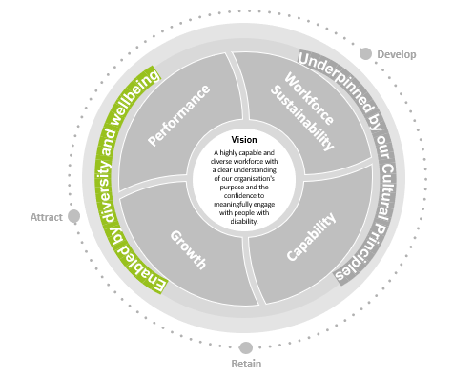





Pillar: Diversity, Inclusion and Wellbeing
Outcomes
Strengths detailed on slide 10
Our Aspiration
We embrace our passion for our common purpose and commitment to workforce diversity, inclusion, wellbeing (both physical and psychological) and meaning into every aspect of work every day. The diversity of skills and perspectives in our community is key to our effectiveness.
Our workforce is diverse and strengthened by the valuable knowledge and experience we offer. We embrace and celebrate our difference, foster resilience and value the importance of connecting wellbeing, contribution and work.
We do this by:
being deliberate in our approach, considering diversity and inclusion in everything we do
recognising the importance that professional lived expertise brings to the work we do as well as contributing to organisational culture
improving access and inclusion of people with disability, striving to be an Employer of Choice
investing in work environments and work design that is safe, accessible, flexible, inclusive, supportive and caring, enabling the workforce, encouraging desired behaviors and supporting new ways of working
embracing a geographically distributed, modern workforce bridging the physical and digital divide
equipping leaders and staff with tools and techniques to enhance team and individual resilience, mental health and psychological safety day to day
leaders and individuals working in partnership to balance personal accountability and responsibility for self-care
aligning all we do to our culture principles, demonstrating how we value our people, drawing on different perspectives, voices and input
Practically success looks like …
Attract, recruit and retain a diverse workforce supply in a highly competitive market, to meet increasing demand (capacity), recruiting talent from different markets with the skills (capability) we need to uphold the rights of NDIS participants, elevate quality and safety and enable consumer independence
Practical and impactful action for lasting change including increased workforce representation from diverse backgrounds and experiences
We strive to enhance diversity, inclusion and wellbeing including being an Employer of Choice, a top performer in the Access and Inclusion Index, and attractive employer in the market for people with disability
In partnership, leaders and workers build capability, enhance engagement and combat the risk of burnout
“I recently had the opportunity to join the Commission as part of the Stepping Into Internship Program. I had a great experience and was able to meaningful contribute to delivering better outcomes for participants.”
“I live in regional Australia, I recently saw a role advertised with the Commission and alongside my passion for the work they do, I was drawn to the flexibility including hybrid work. I intend to apply for the role.”
The workplace wellbeing program has been a great opportunity to connect with my peers and leaders, to focus on practical actions I can take to practice self-care and build resilience.”

Slide 21
5. Delivering the Plan

Slide 22
Next steps and implementation
Delivering the Plan
Next Steps
The Commission continues to scale-up as it transitions from start-up to a mature organisation. Although still in operational infancy, the Commission has made progress and inroads, despite resourcing limitations. There are clear gaps, where resourcing has impacted employee, workforce and organisational capability. To realise our workforce vision and achieve our strategic priorities, and address our workforce risks and opportunities, 40 data-informed opportunities have been identified to guide how the Commission attracts, develops and retains a diverse workforce with the right skills and attributes over the coming five years. Five priority recommendations have been identified as foundational opportunities. Work on some opportunities has commenced, preceding this Plan.
Each initiative has been prioritised into one of three horizons (0 - 6 months, 6 – 18 months, 18 months+). While all opportunities are recognised as important, high-level prioritisation considers the value that the opportunity will bring, the ease at which it can be implemented and associated interdependencies and sequencing, building the necessary maturity and sophistication to fully realise the benefits of the opportunity.
There are a number of supply strategies that can be considered and tailored to ensure the Commission has access to the workforce capabilities and capacity required to deliver on our workforce vision and in turn, our broader purpose and ambition. Key supply strategies include but are not limited to:
buy by hiring new, fully formed talent from outside of the organisation
borrow from industry and global partnerships, agencies, vendors and students
build an internal talent pipeline by investing in the uplift of capabilities and skills
bind talent with the right skills, or high potential, to with a tailored EVP and retention strategies
bound provide lateral development opportunities and cross-team exposure for existing talent to develop the right capabilities
balance redistribute and reallocate resources to high priority areas to improve efficiency and performance while embedding new ways of working
bot to increase efficiency through the use of technology to automate or augment work.
It is important to note, this Plan isn’t an endorsed suite of recommendations or agreed program of work. The recommended opportunities will require further validation and decision making based on organisational priorities, capacity and available funding including endorsement by the ELT. In practice, this means initiatives may not commence immediately and ongoing engagement with key stakeholders will be critical to striking the balance between maintaining momentum and required governance processes.

Slide 23
Opportunities for investment were identified through consultation and inform the Workforce Plan (1/2)
The Commission must capitalise on the skills and capabilities it has today and build for the future
The cultural practices of the past will not serve the Commission in the future
The current performance management approach is not keeping up with workforce needs
Strengths detailed on slide 10
There is underinvestment in leadership, which is critical to the Commission’s success
The Commission operates in a continuously changing environment – facing evolving Government and community expectations, a complex legal and regulatory environment, fiscal pressures, increased public scrutiny and both the impacts of and opportunities for increasing digitisation. This requires a diverse and increasingly sophisticated skills mix such as enhanced regulatory capability for all, successfully navigating complex legal and regulatory requirements including investigative skills, cross-functionally strategic case management, digital and data enabled, risk-based decision making with people with disability at the centre.
The Commission will need to consider how it acquires, develops, sustains and evolves its workforce (capabilities, capacity, design / mix) and how it flexes to deliver on strategic priorities and operational delivery requirements in an efficient, effective and sustainable manner. This will enable the Commission to maintain delivery of strategic and operational requirements, increase ability to ramp up and down as demand changes and flexibly adapt as the operating environment shifts.
The Commission has experienced rapid growth and development from start-up in 2018 and is now transitioning into a scale-up phase. The workforce was shaped organically through the start-up phase and now needs to be considered more deliberately. There is a risk that as the Commission grows it loses some of the strong connections and collaborative practices needed to deliver quality services. As the Commission grows, it will need to invest in structures that encourage collaboration and allow people to communicate across boundaries. Building a culture of collaboration will be key. The Commission has a committed, values-driven workforce with a clear sense of purpose, identity, goodwill and positive values. To support the transition to the future state, cultural shifts will be required -- some behaviours, others mindsets. Our cultural principles will be key to successfully evolving as a contemporary purpose-driven regulator fostering the right values, mindsets and behaviours.
The performance and development management process was established prior to the Commission’s contemporary and future strategic agenda, desired culture and ways of working, and is not well-aligned. For example, the cultural principles do not feature in the process, and there is a need to reinforce expectations that managers will have courageous conversations, hold people to account and challenge behaviours that are not aligned.
The Commission will need to evolve performance management within the context including leveraging existing APS performance management tools and solutions. In time, embedding a one-Commission view on performance management with alignment, visibility and consistency on performance processes across the Commission will be necessary. In turn, focus can shift to increasing clarity and consistency in accountabilities, expectations and priorities.
With a challenging operating environment, significant strategic priorities and dynamic operational delivery requirements, the Commission will need the right leadership capabilities now and into the future, underpinned by core leadership capabilities. Unified leadership across the Commission such as in performance management approaches, career conversations, capability development and planning would be advantageous. Across the Commission there are also perceived succession risks, with limited bench-strength.
Currently, the Commission does not have a structured approach to identifying existing and potential succession risks and developing and implementing succession risk management interventions to mitigate risks. Leveraging existing APS frameworks and tools, the Commission can establish a structured and consistent approach to identifying and mitigating succession risks that contribute to mitigating strategic and operational delivery risks, demonstrate investment in growth and development, improve workforce mobility and in turn retention and engagement.

Slide 24
Opportunities for investment were identified through consultation and inform the Workforce Plan (2/2)
Strengths detailed on slide 10
Increased demand for services cannot be effectively managed/met
The Commission cannot retain enough talent
The wellbeing of the Commission’s people
The Commission must continue to attract a diverse, skilled and experienced workforce
The Commission has increasing and competing strategic and operational demand across all levels and functions. Increases in volumes of work are driving the need for new and innovative approaches to manage surge across registrations, complaints, compliance, reportable incidents, restrictive practices and investigations. Aspects of demand are not always visible, making it challenging to prioritise in a consistent and transparent manner. Throughout consultation, leaders also raised capacity constraints in finding room to think and act strategically while also tactically managing the day to day and leading a team.
Through consultation, senior leaders expressed the view that demand is expected to continue to grow over the next three years as the number of participants requiring support is forecast to increase. The Commission will need to consider how to both prioritise and address demand , enabled by technology, to harness capacity across its workforce, including through surge periods. In turn, this will enable a more agile workforce that can mobilise to prioritise and manage disruptions and reprioritise work in a way that is efficient and keeps the health and safety of the workforce at the forefront.
How employees experience work, ways of working and culture is key in talent retention and performance. The experiences of Commission employees may be mixed and may result in challenges from collaboration, engagement, retention and/or performance and productivity perspectives. For example; staff report mixed experiences in on boarding, access to capability development opportunities, access to career progression opportunities, performance conversations, flexibility and workload constraints. Equally, we know many people are attracted to, and stay at the Commission, because they are involved in purpose-driven work, they care about the outcomes for the community and they want to be part of the bigger picture.
The Commission will need to be deliberate in how it designs and communicates its employee experience and importantly, how it delivers on its promised experience (i.e. how it embeds it consistently and equitably), in order to attract and retain talent and motivate performance. The Commission should consider embedding a one-Commission employee experience with people at the heart, where the workforce experiences are consistent across the employee lifecycle, feeling connected and having the role clarity and organisational acumen, competencies and skills needed to deliver.
The Commission is committed to the health, safety and wellbeing of its people. Throughout consultations, some raised the potential risks around wellbeing associated with the nature of the work the Commission does, the passionate, purpose-driven workforce, coupled with the impacts of the COVID-19 pandemic.
Further, there is a sense that requirements are added on without stopping or pausing other requirements (e.g., projects, programs of work, strategic initiatives, business as usual).
To continue to foster an environment and culture where the health, safety and wellbeing of the workforce is our priority, the Commission will continue to identify and address health, safety and wellbeing risks and consider and address the potential change impacts as it evolves to its desired future state.
Diversity will be key in bringing different perspectives and ideas together, supporting a compelling employee value proposition and ensuring that the Commission is reflecting the communities that it serves and the partners it works with. The Commission has leaned heavily on the successful attraction and retention of talent from across social services, particularly those working in the disability sector including social workers, case workers, clinicians and investigators out of law enforcement.
There are opportunities to tap into different segments and sectors of the labour market to increase workforce participation, improved diversity, inclusion and a sense of true belonging. The Commission should focus on creating inclusive environments for all staff and recognise the value of diverse perspectives, varied expertise, and lived experience, in organisational culture.
Continuing to foster diversity and inclusion will be key to meeting future demand, as well as improving diversity and inclusion outcomes.

Slide 25
Identified quick wins
The following opportunities have been identified as quick wins to support early, iterative progress toward opportunities contained in this Plan. Each opportunity is intended to represent minimal effort and require minimal investment. Acknowledging work on some opportunities has commenced, preceding this Plan.
Harness existing best practice and iterate (New!)
A ‘working well’ initiative to share and learn from the experiences of teams having success across the Commission in staff attraction, engagement, retention – what are they getting right, how are they doing it, what are their teams saying and how can that experience be replicated to incrementally enhance outcomes across the Commission. This could be done through focus groups as well as dedicating a portion of the SLT Forum agenda to interactive ‘speed sharing’ round tables where SLT members can join 1-5 groups discussing different areas of interest and taking some tips and tricks away that they may choose to implement in their own teams .
Continue building diverse talent pipelines (Existing)
Attract more university students nearing the end of their degrees to help with capacity and build capability and early career pathways through placements (behavioural support), vacation opportunities and internships (compliance, reportable incidents). Pilot a small number of placements by exploring existing professional networks of the Commission’s Senior Leaders, expanding the network beyond the existing arrangement with ANU to other tertiary institutions such as Western Sydney University, Macquarie University. The Commission could identify institutions that are both geographically co-located near offices and/or offering area of study in high demand by the Commission. Areas of study, could include; public relations, allied health, education, social services, consumer engagement and ICT.
Increase diversity of the candidate pool by introducing increased flexibility and remote work optionality. This could include communicating and advertising roles with flexible work arrangements and including multiple locations; to support attracting talent from a range of geographical locations.
Trial LinkedIn Recruiter to access a wider talent pool and build a candidate pipeline
Employee exiting insights and data (New!)
Develop and implement an exit survey including offer of exit interview as a first step to enhancing availability of workforce sentiment surrounding staff retention and turnover. The short survey (8-10 questions), would be sent and managed centrally by the People team when notified of resignation.
One Commission new starter induction program (Existing)
Kick off a light version of the induction program for all new starters commencing at the Commission to support building consistency of a one commission mindset, organisational purpose, roles and responsibilities of functions, support new connections as well as setting expectations and introducing core professional capabilities around risk, regulation and disability awareness. Pilot condensing the recommended timings for the modules and running the program once monthly for half a day. This induction program can be expanded overtime forming part of an on boarding program, by the incorporating additional content, including interactive activities and involving guest speakers presenting different elements of each modules
Employee recognition
Leverage the existing employee reward and recognition program to establish a regular cadence of celebrating and recognising team members. This can be done in line with the Commission’s five cultural principles; Impartial; Committed to service; Accountable; Respectful and Ethical. As a first step this can be introduce at team meetings, with leaders giving ‘shout outs’ and recognising the contribution of employees. Opportunities can be opened up to the meeting and anyone else wanting to recognise other team members.
Understanding of roles and responsibilities around the Commission (New!)
Create a shared understanding of how everyone contributes to our purpose and ambition by having each business area develop and publish a slide pack or short video on who they are and what they do and how their area operates. This can be used as an onboarding resource while a more formalised program is developed.
Learning and development (New!)
Implement protected learning time, for all employees across the commission where calendars are blocked out for x number of hours periodically, for focus time on learning and development.

Slide 26
Broader opportunity roadmap for consideration
To realise our workforce vision and achieve our strategic priorities, and address our workforce risks and opportunities, 40 data-informed opportunities have been identified to guide how the Commission attracts, develops and retains a diverse workforce with the right skills and attributes over the coming five years. Each initiative has been prioritised into one of three horizons (0 - 6 months, 6 – 18 months, 18 months+). While all opportunities are recognised as important, high-level prioritisation is undertaken to also consider the value that the opportunity will bring, the ease at which it can be implemented and associated interdependencies and sequencing, building the necessary maturity and sophistication to fully realise the benefits of the opportunity. Acknowledging work on some opportunities has commenced, preceding this Plan.
New starter induction and on boarding
Core capability program
Performance management framework and planning processes
Early EVP and Workforce data and insights initiatives
Building capability and cross skilling
Diverse talent pipelines
Collaborative ways of working
Diversity and wellbeing network
Review of PD, role mapping, Contracts
Recruitment
Capability and strategy
WS1
C1
WS4
WS7
DIW2
WS10
G2
P1
WS3
WS8
DIW1
Diverse talent pipelines
WS2
WS6
DIW4
C5
C7
Employee recognition
P7
C2
G5
Performance management
DIW7
DIW3
C3
DIW5
DIW6
WS9
National framework
P5
G3
P3
G8
Leadership development
Resource prioritisation
L&D
C4
EVP
P2
G7
C8
G1
P4
G4
WS5
P6
C6
G6
Today
0 – 6 months
Horizon 1
6 – 18 months
Horizon 2
18 months +
Horizon 3
KEY
Workforce Sustainability pillar
Capability pillar
Growth pillar
Performance pillar
Diversity, Inclusion and Wellbeing pillar
26

Slide 27
Opportunities and recommendations
Strengths detailed on slide 10
To initiate the implementation across the workforce pillars, 5 priority recommendations have been identified (below). These recommendations are imperative to creating a foundation for future opportunities the Commission may want to undertake. These recommendations are considered no-regrets investments, that are low risk decisions the Commission can make to respond to immediate priorities. Each recommendation can also be undertaken in incremental steps, initially through a ‘zero investment’ lens – exploring innovative ways to redirection and reprioritise effort. Acknowledging work on some opportunities has commenced, preceding this Plan.
Foundation priority opportunities
Workforce Pillar
Induction and on boarding Equip our workforce with a ‘One Commission’ approach and mindset from day one through design and delivery of a ‘One Commission’ new starter induction program that educates, connects and confirms expectations of new starters to our operating context, organisational priorities, structures, ways of working and introduces core skills for all roles delivered as part of a staged on boarding experience. Appoint an SES Officer as Diversity Champion and establish a workforce-led Diversity, Inclusion and Wellbeing Officers Network to sponsor, promote and lead the strategic direction for diversity initiatives. The Commission can leverage diversity champions and the wider network officers to introduce and speak to wellness initiatives during the new starter induction program
WS1, DIW3
Core capability program Develop a ‘One Commission’ core capabilities program for all staff, leveraging the shared knowledge, capability and resources internally and external across our broader regulatory community and disability sector to support capability development across a core set of foundational competencies. Core capabilities can be anchored in targeted development and learning, as well as other opportunities such as Induction and on boarding.
C1
Performance Management Develop, embed and normalise consistent, repeatable and engaging performance planning processes that enables: performance discussions between leaders and workers with each worker to have their own Professional Development Plan (PDP). Leaders to manage performance consistently and effectively, the Commission's cultural principles to be embedded in performance discussions, describing desired behaviours, attitudes and mindsets, our ability to identify and nurture talent including capability development, talent management and succession planning and improved collection and reporting on training and development to inform future needs.
P3
Workforce Data and insights Enhance capture and use of workforce data to create transparency of the current and future workforce to inform decisions and action. Continue gathering workforce insights across the employee lifecycle. Continue to invest in visualising workforce data as well as establishing job architecture to enable granular job-role analysis to support data driven decision-making and strategic workforce planning. Start with data already available in the Commission and iteratively consider additional data collections to support further analysis over time. Implement employee entry and exit processes centred on collecting and collating exit feedback and data, to support continuous improvement on the employee experience and understanding exit reasons. Continue engaging with employees to seek feedback and gather workforce insights including design and implementation of short Employee Value Proposition (EVP) survey and tailored employee engagement quarterly pulse surveys.
WS2, P7, G8
Diverse talent pipelines Continue building diverse talent pipelines by leveraging existing, external programs, partnerships and resources to customise and enhance the recruitment, selection and on boarding processes for our identified diversity groups as well as reviewing and refining current recruitment approaches ensuring a diverse talent pool by appealing to and targeting different segments of the labour market including showcasing the possible career paths and roles across the Commission.
DIW3, G3

Slide 28
Pillar: Workforce Sustainability
Opportunities
Value
Ease
Horizon
WS1 Equip our workforce with a ‘One Commission’ approach and mindset, creating a shared understanding of our purpose, and the roles of other people and teams throughout the Commission. Leverage on boarding from day one through design and delivery of a ‘One Commission’ new starter induction program that educates, connects and confirms expectations of new starters to our operating context, organisational priorities, structures, ways of working and introduces core skills for all roles delivered as part of a staged on boarding experience
WS2 Continue engaging with employees to seek feedback and gather workforce insights across the employee lifecycle to inform key employee experience decisions and the translation and communication to the candidate market. Iteratively embed materials into workforce initiatives, including design and implementation of short Employee Value Proposition (EVP) survey and tailored employee engagement quarterly pulse surveys to complement the annual APS Census and enhance understand workforce engagement and sentiment
WS3 Broaden target market for recruitment by exploring new and different approaches to attract and grow new talent pipelines to assist with future demand, surge capacity and workload using flexible contingent workforces in areas of high demand, such as the contact centre. For example an early career program in the form of internships, cadetships, school pathway program, mentor programs or casual hub in partnership with universities/vocational institutions
WS4 Leverage partnerships with other regulators, authorities and agencies to facilitate mobility, secondment and/or exchange program to access a broader workforce, lift capability and grow career experience, leveraging work in progress and learnings from mentoring programs currently in development, led by the APS Working Group
WS5 Develop and activate a contemporary EVP bringing to life the practical experiences and value of working in the Commission, what this means and looks like -- articulating the Commission’s tangible and intangible value propositions, competitive advantage and differentiating factors. In turn, informing targeted recruitment, talent planning and reward and recognition activities
WS6 Establish an informal mentoring program across service lines to enhance collaboration, knowledge sharing and mobility, leveraging work in progress and learnings from the existing mentoring programs in development across the APS Working Group
WS7 Enhance technology enabled distributed ways of working supported by digital tools providing an opportunity for workers to connect, learn and collaborate across distributed workplaces and spaces, enabling greater collaboration and asynchronous ways of working
WS8 Develop strategic workforce capability, informed by deeper workforce analytics including workforce demand/supply modelling across workforce segments and critical roles to determine specific capacity and capability risks and mitigations. Start with data already available in the Commission and iteratively consider additional data collections to support further analysis overtime, including drawing on output of P7, C5
WS9 Review external workforce contracts, assess future needs and stagger end dates where possible, prioritising critical roles
WS10 Undertake succession planning and talent mapping at the branch or divisional level and above to ensure a future pipeline of talent.
High
Moderate
1
High
Moderate
1
High
Moderate
3
Moderate
Moderate
2
High
Moderate
2
High
High
2
Moderate
Moderate
2
High
Low
3
High
High
2
High
High
1
Value denotes the indicative level of impact that the opportunity will have towards achieving strategic aims, Ease represents the indicative level of resourcing, effort and time it will take to achieve this initiative

Slide 29
Pillar: Capability
Opportunities
Value
Ease
Horizon
C1 Develop a ‘One Commission’ core capabilities program for all staff, that operates as the first iterative step to C2, leveraging the shared knowledge, capability and resources internally and externally across our broader regulatory community and disability sector to support capability development across a core set of foundational competencies. Core capabilities can be anchored in targeted learning programs and other opportunities such as Induction and on boarding. Core competencies include:
C2 Develop an organisation-wide core capability framework, drawing on the org wide capability analysis (recently completed), leveraging established external training and coordinated learning and development opportunities to build capability including design of an ongoing learning and development program including on-demand micro-learning
C3 Implement protective training time for upskilling and training employees that is consistent and accessible to all employees across the Commission and is aligned to individual professional development plans. This could include: formal training courses, non-compulsory learning sessions, opportunities to attend industry forums, webcasts and leverage industry offerings
C4 Enable on-the-job capability and cross-skilling through job sharing, shadowing and secondments. This could be done by creating a register of interest, regular conversations with staff, professional development plans
C5 Consider mapping roles to the APS Job Family Framework to enable the ability to undertake workforce segmentation as a first step to developing job architecture, leveraging the resources and work of the APS Workforce Planning Community of Practice Job Family Framework Hub
C6 Dual track leadership development (technical and managerial) delivering across all levels (Executive to emerging front line leaders) Integrating both formal and informal learning opportunities whilst incrementally and consistently building leadership capability at each level including emerging leaders. Commencing with fundamentals of supervision and leadership training encompassing a capability uplift of all leaders, to both manage and lead hybrid teams effectively driving an engaged and innovative workforce
C7 Design targeted recruitment programs to attract graduates into priority and critical roles such as those roles contributing to complex case management, and business and data analytics, supporting the Commission to build the right skills for the future
C8 Implement and embed the 70/20/10 L&D framework into development planning (PDP conversations, coaching conversations), incorporating 70% on the job training, 20% individual learning and 10% formal learning, consolidating employee formal learning into day-to-day experience supporting employees to develop the right skills and capabilities
High
High
1
Consumer Centricity
Acts with empathy and demonstrates resilience
Understands the operations of the commission
Deals with consumers respectively
Regulation and Risk
Understands the application of regulation
Understands relevant legislation
Understands the disability sector
Applies critical thinking
Understands risk management
Data and digital
Intelligence led, technology enabled decision making
Provides data driven insights
Seeks opportunities to innovate
Leverages digital channels
Leadership
Lead and motivates others
Promotes a sense of purpose and wellbeing
Role models cultural principles
Leads and manages self
Prioritises effectively
Brings a growth mindset
High
Moderate
2
High
High
2
High
Moderate
2
High
Moderate
2
High
Moderate
2
Moderate
Moderate
3
Moderate
Moderate
3
Value denotes the indicative level of impact that the opportunity will have towards achieving strategic aims, Ease represents the indicative level of resourcing, effort and time it will take to achieve this initiative

Slide 30
As the Commission continues scaling it also needs to leverage diverse sourcing strategies to deliver on its role and purpose
Please note: This is a high-level assessment that would be enhanced through further detailed analysis. The critical capabilities shown arose out of consultation and have been aligned to the occupations contained within the labour market scan (see slide 13) drawn from the Australian Skills Classification. The table below is not intended to be exhaustive but represents the skills and capabilities where no-regrets investments could be made in the near term.
  Buy
  from outside the organisation
  Borrow
  from industry and partnerships, agencies, vendors and students
  Build
  an internal talent pipeline by investing in the uplift of capabilities and skills
  Assumptions
  Regulatory capability
Regulatory capability is a core and critical part of the Commission’s purpose. Building this capability over time will ensure there are career pathways, but the Commission will also need to have a sustained focus on retention and maturity of the capability over time.
At times, there may be a need to supplement the build approach with buying from the market; either to bolster capacity and/or fresh thinking. This may also help to boost capacity in the short term.
  Inspectors, Regulatory Officers
  Judicial and Legal Professionals
  Risk capability
Aspects of the risk capability of the Commission will not require Commission-specific knowledge, such as project administration, and may easily be bought from the market.
Some roles will benefit from a build approach to create a consistent methodology and practice that can support the delivery of consistent experiences for NDIS participants and providers.
  Intelligence and Policy Analyst, Investigators
  Contract, Program, Project Admin
  Data and Digital capability
Data capability is in high demand in the market. Being able to immediately buy or borrow will enable immediate support to the Commission around backlogs, establishing foundational data capability and other key priorities to implementing the Digital and Data Roadmap
However, over time, investing in building specialist data analysts that can overlay data capability with the specific investigative skills required by the Commission will be impactful to operations.
  Data Analyst
  Information Officer
  Leadership capability
Organisations tend to seek to build their leadership capability, ensuring the organisation is led by people who understand the purpose, the context and the workforce. This is then supplemented by Buy/Borrow strategies that bring in fresh perspectives and new partnerships.
Other roles that support a leadership capability can be bought, such as change management. These roles may be time-bound to transformations, and are found more readily in the market.
  Health and Welfare Manager
  Change Management
  Consumer centric capability
Similar to the regulatory capability, consumer centric capability, that enables the ability to deliver high quality consumer experiences is at the heart of the Commission’s purpose and reputation. While these roles can be found in the market, the Commission will always need this capability, often at scale. For these reasons it may be beneficial to invest in a build strategy for roles that sit in this capability.
  Policy and Planning Manager
  Community Worker
  Contact and Call Centre Workers
The Commission needs: a sustainable workforce approach that enables collaboration; to invest in developing the right capabilities and providing growth for its people; to empower its people to be high performing; and to invest in how it delivers on its vision for a diverse, inclusive and healthy workforce.

Slide 31
Growth
Opportunities
Value
Ease
Horizon
G1 Enable increased flexibility into the future by cross skilling the operational workforce to develop capability and an understanding of roles, responsibilities and activities across business units to support cross functional skill transfer
G2 Explore new informal, employee-led communication channels at a national level, pilot ‘All Hands’ engagement, learning circles/’learning bites’, panel discussions, ‘One Commission’ recorded webcasts, and cross functional meet-ups to support professional development, and understanding while encouraging connection, informal learning and growth
G3 Review and refine current recruitment approaches ensuring a diverse talent pool by appealing to and targeting different segments of the labour market including showcasing the career paths and roles across the Commission, drawing on existing early career programs and initiatives across the APS
G4 Develop and design sustainable career pathways from entry to advanced roles, considering cross-skilling, graduate pathways and secondments that focus on critical capabilities, supporting internal mobility as well as cross regulatory and sector mobility.
G5 Undertake talent planning including developing a flexible succession planning approach centred on critical and priority roles, by workforce segment considering both technical and leadership capability. Use workforce mobility to assist with capacity, cross-skilling and retention and to support succession risk planning and building talent pipelines
G6 Develop, iterate and embed an approach that prioritises and allocates resourcing and work across all levels of the Commission (projects, programs of work, strategic initiative, BAU), aligned to the business planning process
G7 Develop and embed a consistent national framework that outlines how ‘work and when’ gets done. This could include mapping out processes and workflows
G8 Develop an employee entry and exit process centred on collecting and collated exit feedback and data, to support continuous improvement on the employee experience, understanding exit reasons, why people are leaving and where they are going
High
Moderate
2
High
High
2
Existing initiative
High
Moderate
1
High
Moderate
2
High
Moderate
2
Moderate
Moderate
2
Moderate
Low
3
High
High
1
Value denotes the indicative level of impact that the opportunity will have towards achieving strategic aims, Ease represents the indicative level of resourcing, effort and time it will take to achieve this initiative

Slide 32
Performance
Opportunities
Value
Ease
Horizon
P1 Refine and review position descriptions ensuring all employees have clearly defined roles, responsibilities and measurable objectives that align the Commission’s strategic objectives, cultural principles and overall purpose
P2 Develop and embed a consistent approach to articulating performance requirements, accountabilities and expectations to increase understanding and alignment of roles and priorities, feedback and recognition from the outset of employment
P3 Develop, embed and normalise consistent, repeatable and engaging performance planning processes that enable:
Informal and formal performance and development discussions between leaders and workers with each worker to have their own Professional Development Plan (PDP), that provides opportunities to set individual and team goals and stretch targets aligned with and cascading from the Commission’s strategic objectives and planning processes
leaders to manage performance consistently and effectively, in alignment with existing NDIS Commission and the APS performance policies and frameworks
the Commission's cultural principles to be embedded in performance discussions, describing desired behaviours, attitudes and mindsets necessary to be a contemporary purpose-driven regulator
our ability to identify and nurture talent including capability development, talent management and succession planning
improved collection and reporting on training and development to inform future needs
P4 Utilise the APS talent management guide and toolkit to provide a framework for high potential and engaging career conversations, linking into succession planning and tailored talent development and APS Academy Leadership and Management Offering*
P5 Leverage the existing employee reward and recognition program
P6 Establish a Behavioural Framework outlining behavioural expectations aligned to the values and cultural principles of the Commission. Behavioural frameworks are embedded into performance management conversations, and support recruitment and selection processes
P7 Continue to invest in visualising workforce data to enable granular job-role analysis to support data driven decision-making and strategic workforce planning. Start with data already available in the Commission and iteratively consider additional data collections to support further analysis overtime**
High
Moderate
2
High
Moderate
2
High
Moderate
1
Moderate
Moderate
2
High
Moderate
2
High
Moderate
2
Moderate
Moderate
1
Value denotes the indicative level of impact that the opportunity will have towards achieving strategic aims, Ease represents the indicative level of resourcing, effort and time it will take to achieve this initiative
*The APSC continues to develop the APS Academy, an enterprise-wide learning and development initiative expected to support individual agency L&D activities. The APS Academy Leadership & Management offering includes: The Public Sector Management Program (PSMP) for APS6-EL2 staff , the SES Leadership Capability Framework and secondment opportunities (including Jawun), Sir Roland Wilson Foundation PhD Scholarship. **Also leverage resources available via APS Human Resources (HR) Working Group, developed to provide an agile approach to mature the working planning capability across the APS in a structured and engaging manner.

Slide 33
Pillar: Diversity, Inclusion and Wellbeing
Opportunities
Value
Ease
Horizon
DIW1 Appoint an SES Officer as Diversity Champion and establish a workforce-led Diversity, Inclusion and Wellbeing Officers Network to sponsor, promote and lead the strategic direction for diversity initiatives, represent the Commission at external networks and support ongoing initiatives. The Commission can leverage diversity champions and the wider network officers to introduce and speak to wellness initiatives during the new starter induction program WS1.
DIW2 Develop a Diversity and Inclusion Strategy and Action Plan that outlines our whole of business approach to improving access and inclusion for our identified diversity groups, embedding the voice of those with a lived experience in disability and striving to be an Employee of Choice of people with disability including a clear goal to increase representation of people with disability working at the Commission
DIW3 Continue building diverse talent pipelines by leveraging existing, external programs, partnerships and resources to customise and enhance the recruitment, selection and on boarding processes for our identified diversity groups. Other strategies may include embracing a geographically distributed workforce in a hybrid environment, including review of the Flexible Work Policy for opportunities and barriers to attract and retain a diverse, modern workforce. Other considerations may incrementally include: introducing remote work optionality in specified circumstances, advertising roles with part or full time optionality
DIW4 Leverage Australian Network on Disability membership and keep up to date with best practice in accessibility and inclusion including annual participation in the Access and Inclusion Index
DIW5 Pilot an early career program (internship/work experience programs) to support people with disability to develop valuable skills and experience, leading to pathways for employment, drawing on existing external resources such as participation in the Australian Network on Disability Stepping Into internship program or the Services Australia Aurora Neurodiversity Program in partnership with Specialisterne
DIW6 Introduce a Wellbeing Program to support leaders and the broader workforce to foster physical and psychological wellbeing, build capability and combat burnout including training in debriefing, reflective practice, self-care and mentoring. Initially, introduce a program of informal, tailored learning opportunities, such as virtual wellness workshops and panel discussions to build momentum, educate and promote awareness
DIW7 Invest in tools, systems, processes and resources that support and enable inclusion, belonging and wellbeing in our everyday work life such as workflow, case load management and collaboration tools (Refer Digital and Data Roadmap) and establishing a national register of community contacts
High
High
1
High
Moderate
3
High
High
1
Moderate
Moderate
2
High
High
2
High
Moderate
2
High
Low
3
Value denotes the indicative level of impact that the opportunity will have towards achieving strategic aims, Ease represents the indicative level of resourcing, effort and time it will take to achieve this initiative

Slide 34
Appendix

Slide 35
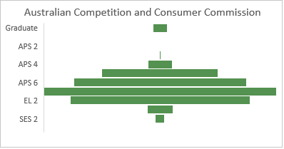
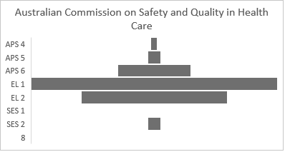
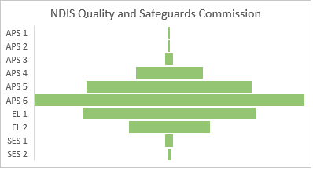
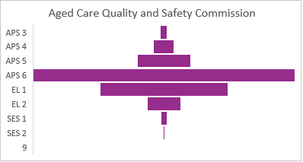
Appendix A: Current state benchmarking
Turnover Rate
Headcount by classification
NDIS Quality and Safeguards Commission*
Aged Care Quality and Safety Commission
FY21
15.2%
FY22
26.1%
13.2%
N=523
60% APS6 and above
N=590
84% APS6 and above
Australian Commission on Safety and Quality in Health Care
Australian Competition and Consumer Commission
16.2%
11.6%
N=62
95% APS6 and above
N=1049
80% APS6 and above
35
*Note: There is a +2.9% differential in the FY22 turnover rate shown using the current state data provided by the Commission in comparison to the rate published in the APS employment data 2022
N=total headcount as per APS Employment data FY22
Source: Current state workforce data as at June 2022 | APS Employment data June 30 2021 – June 30 2022

Slide 36
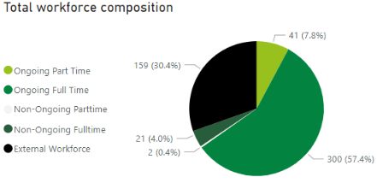
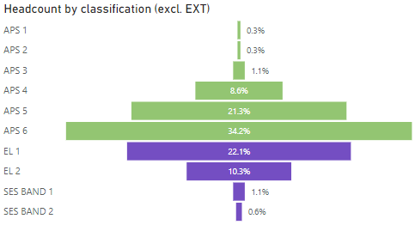
Current state workforce profile (1/2)
Workforce composition and flexibility
Key metrics
The Commission currently draws on a blended workforce model of employees and an external, contractor workforce. Following a change of government policy, the Commission is seeking to increase the proportion of APS within the workforce. Working full-time continues to be the most common employee work pattern (88%), with potential opportunity to access and attract talent from diverse talent pipelines by offering part time and flexible options.
Almost 50% of the external workforce is spread across three functions that commonly require surge capacity including Reportable Incidents (21.4%), Complaints (13.8%), Contact Centre (10.7%). The remainder of the external workforce is dispersed across 21 teams, in part, reflecting the importance of flexible engagement options to attract and retain talent*. Ongoing consideration of the blended workforce model will be necessary in order to optimise the mix taking into account the nature and future need for roles performed (sustain surge capacity and/or fill broader capability gaps), length of contracts, market conditions and lead time to competency.
523
Total workforce headcount
364
Total employee workforce headcount
159
Workforce classification by headcount
The Commission’s current workforce classification profile is most aligned to the typical shape of an Operational (Delivery) APS Agency rather than a Policy Agency. The APS 4–6 cohorts account for almost 65% of the Commission’s workforce headcount**, followed by the Executive Level cohorts (EL1 and EL2), accounting for almost 22%.
As the Commission continues the transition as a contemporary regulator, moving from start-up to scale-up, shifts in the classification profile are expected. Determining the future strategy mix as both a delivery and policy agency will be an important strategic discussion. In time, undertaking strategic workforce planning would provide an opportunity to model changing workforce demand across work functions to understand evolving workforce needs over time.
The APS 6 cohort operates at the heart of both delivery and policy. As the single largest workforce cohort (36%), developing career pathways, enhancing technical capability, coaching and fostering leadership potential and performance across this cohort will be essential in retaining this cohort and supporting an engaged, skilled and sustainable workforce.
The workforce composition of the Commission generally has fewer EL staff as a proportion to some other regulatory agencies such as the ACCC and ACSQHC (See Appendix A)
Total external workforce headcount
43.5
Average
age*
26.1%
Turnover
rate**
Source: Current state workforce data as at June 2022 | * See Appendix B for full workforce headcount breakdown by organisational unit and broader workforce by organisational . **Excludes external workforce/contractor/consultants (n=159) due to data availability
Note: There is a +2.9% differential in the FY22 turnover rate shown using the current state data provided by the Commission in comparison to the rate published in the APS employment data 2022

Slide 37
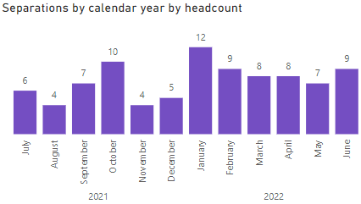
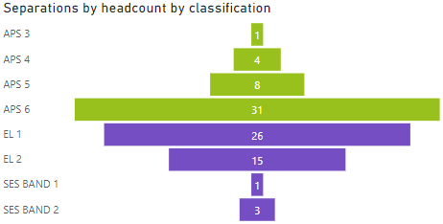
Current state workforce profile (2/2)
Our capabilities
Turnover analysis
The Commission’s workforce has deep capability, held functionally as pockets of expertise across the organisation. Through consultation, core behavioural strengths in empathy, commitment and purpose were evident as well as deep capability and experience in:
Throughout consultation continuing to grow capabilities in the following areas also emerged as a key focus:
As the Commission scales-up, it must embed core competency across functions, enhancing the depth and breadth of our existing skills and capabilities as ‘One Commission’. This will enable the Commission to build confidence and capability so that staff can operate as ‘regulatory officers’ of the Commission.
Developing and embedding core capabilities across all roles will also enable the continued growth and development of our workforce and enable the Commission in the achievement of its vision.
The Commission has experienced relatively high turnover in the previous financial year equating to 26.1% of total ongoing employee headcount (341). Combined, the APS6 (31) and EL1 (26) cohorts accounted for 52% of all employee separations in FY22.
Future potential turnover is reflected in the 2022 APS Employee Census 74% of NDIS QSC respondents indicated that they wanted to leave their current position as soon as possible (12%), within the next 12 months or in the next one to two years (38%).
There are many reasons for turnover to occur. Research indicates higher than average turnover in start-up organisations moving into scale-up. This tends to be due to factors such as: limited budgets, higher demands, manual processes and practices and availability of modern equipment and technology including collaboration tools¹. Understanding any specific drivers in the Commission will continue to be important for investment in retention strategies.
Further analysis and data capture is recommended to gain a deeper understanding of the drivers of turnover and retention. This may be undertaken through the existing APS Census Working Group, SLT forum as well as exit survey and/or interviews.
Regulatory Compliance
Clinical behavioural support
Strategy and Policy
Service Delivery
Legal
Regulatory Approach
Investigations
Education, Engagement and Communications
Pre pandemic, the average turnover rate sat at around 10.9%². The current turnover rate of the Commission is 26.1% This is generally higher then other regulatory agencies (See Appendix A).
Consumer Centricity
Regulation and Risk
Data and Digital
Leadership
Source: Current state workforce data as at 27 Sep 2022 | * Data limitations on availability of job families and workforce segments. Organisational unit has been cleansed of work location for each of visual representation. **Excludes external workforce/contractor/consultants (n=159) due to data availability | 1 Salesforce Why Start-ups Face High Attrition Rates, 2022 | 2 PwC what Workers Want report, 2022
| Note: There is a +2.9% differential in the FY22 turnover rate shown using the current state data provided by the Commission in comparison to the rate published in the APS employment data 2022

Slide 38
Appendix C: Opportunities
Opportunity spotlight: ‘One Commission’ New Starter Induction Program (WS1)
Strengths detailed on slide 10
Equip our workforce with a ‘One Commission’ approach and mindset from day one through design and delivery of a ‘One Commission’ new starter induction program that educates, connects and confirms expectations of new starters to our operating context, organisational priorities, structures, ways of working and introduces core skills for all roles delivered as part of a staged on boarding experience. An effective on boarding program enhances the employee experience from the start of employment, whilst also enabling a consistent approach to on boarding.
Who will be participating: all new starters
Who will deliver the induction: Modular delivery with ELT guest speakers, SMEs, Leaders, People team, those with a lived experience with disability.
How often will this be delivered: once per month/fortnightly/weekly
How will this be delivered: As a one day program and/or flexible, modular delivery e.g. virtually with a face-to-face or hybrid alternative
Module one (1 hour)
Welcome to the Commission
Introductions and getting to know other new starters
What it means to be a contemporary regulator
Working as ‘One Commission’, approach and mindset
Our ambition, purpose and strategic direction
Module three (2 hours)
Purpose/role of Commission and our broader landscape
Commission functions and structure
Overview of some of the roles and responsibilities
Examples of the work undertaken by the Commission
Module five (1 hour)
Senior Leader Interactive Q&A
Summary of modules
Designing my personal new starter action plan
Wrap up and next steps
Post induction
Follow up new starters with a survey to capture insights and data on their experience
Create a virtual community for new starters to continue connecting and asking questions
Assign a buddy to connect with beyond the session
Welcome to the Commission
Our ways of working
Who we are and what we do
Our core capabilities
Building culture and connection
Module two (1 hour)
Understanding our cultural principles
Our employee rewards and recognition program
Key policies, procedures, documents and mandatory training
Our systems and tools
Where to go for help and more information
Module four (4 hours)
The role of a contemporary regulator, the approach and the role the Commission plays to drive quality and safeguarding
An introduction to risk, risk based approaches
Introductory disability awareness
How this comes together
Overtime, with this implementation of further opportunities the commission can incorporate other initiatives into the induction program. This could include DIW1, having a wellness module where DIW Officers introduce the Commission’s strategic direction for diversity and any ongoing initiatives around Diversity, Inclusion and Wellbeing.
38

Slide 39
Opportunity spotlight:
‘One Commission’ New Starter Induction Program (WS1)
Equip our workforce with a ‘One Commission’ approach and mindset from day one through design and delivery of a ‘One Commission’ new starter induction program that educates, connects and confirms expectations of new starters to our operating context, organisational priorities, structures, ways of working and introduces core skills for all roles delivered as part of a staged on boarding experience. The previous page describes the induction program (which forms one part the on boarding journey) in detail. Outlined below are some early on boarding activities that can be implemented over 6 months.
Pre on boarding
Day 1
Week 1
2 – 3 week check in
Month 1
Month 3 - 6
Welcome checklist sent
Welcome phone call or email and day 1 arrangements are confirmed
Establish and confirm work schedule
Added to all relevant recurring meetings, Microsoft Team groups, distribution lists and objective folders
Attended the ‘One Commission’ induction program
Received Week 1 survey
Check-in with Manager to discuss the past Month
Review and finalise goals and development plans
Received 1 month survey
Security pass, desk assigned and Login/Computer access
Provide office and amenities tour
Introductions to the team and buddy
Discuss new role and expectations in more detail
Begin the professional development plans, goal and milestone setting process
Connected with new starter community
Undertaken mandatory APS training
Completed all "must have" on boarding activities
Completed all new starter Learning bites
By referring to the on boarding roadmap, I know what I need to do as a leader, to support my new team member at each stage of their on boarding journey and set them up for success.
39

Slide 40


















Opportunity spotlight:
Broaden our target market for recruitment (WS3)
Broaden our target market for recruitment by exploring new and different approaches to attract and grow new talent pipelines to assist with future demand, surge capacity and workload using flexible contingent workforces in areas of high demand, such as the contact centre. For example, an early career program in the form of internships, cadetships, school pathway program, mentor programs or casual hub in partnership with universities/vocational institutions
Target talent pipeline
Establish an employee referral program
Early career hires such as school leavers, university students and graduates
APS employees
Experienced APS lateral hires
Lateral hires from the private sector
Previous employees
Qualified past candidates
Diversify recruitment sourcing channels and utilise niche job boards and candidate networks to increase the volume and diversity of candidates.
Network and proactively approach prospective candidates from across the sector
Re-engage qualified past candidates
Connect with universities close-by to our existing geographic footprint - Utilise University Online Jobs Portals, University vacation employment programs and career fair exhibits (virtual and in person)
Optimise our career pages and develop more engaging job ads designed to share the Commission community, purpose and experience, and the value the candidate can add
Practical opportunities for exploring new and different approaches to attract and grow new talent pipelines
Establish a Temporary Employment Register
Reduce barriers to application by introducing practical and tailored questions for candidate application processes
Offer flexible, hybrid and remote work options in full time, part time or on a job share basis to maximise candidate pools including in regional locations.
Encourage employees to boomerang -- Keep in touch with previous employees -- some of your best candidates may be former employees.
40

Slide 41
Opportunity spotlight:
‘One Commission’ Core Capabilities Program (C1)
Develop a ‘One Commission’ core capabilities program for all staff, leveraging the shared knowledge, capability and resources internally and external across our broader regulatory community and disability sector to support capability development across a core set of foundational competencies
As the Commission continues to evolve from a start-up and begins to scale-up, so will the breadth of workforce capabilities required for both the current and future state. Throughout consultations we heard that the Commission has some unique strengths in areas such as consumer care and empathy. However, changes in the operating environment, an increase in the volume of work, advancements in technology are creating a need for new skills, particularly in areas such as regulatory and risk capability, critical thinking, escalation, and leadership. There was also a recognition that while there were some pockets of depth of expertise, there was increasingly a need for core capabilities in the above skills. A Core Capability Program may enable a more consistent approach to the development of skills, knowledge and attributes across the Commission. Through stakeholder consultation 14 core capabilities were identified, the below represents examples of the themes and insights captured across the consultation process. There are also practical steps the Commission can undertake to start weaving through core capabilities.
Consumer Centricity
Regulation and Risk
Data and Digital
Leadership
Acts with empathy and demonstrates resilience, committing to achieving quality outcomes
Understands the operations of the Commission and how and when to refer/escalate cases in order to deliver on the responsibilities of the Commission
Deals with consumers respectfully and represents the Commission with integrity, building public trust
Understands the Regulatory Approach and how the Commission uses the full set of levers and tools to drive quality and safeguarding
Understands relevant legislation and how it applies to the roles of the Commission
Understands the disability sector in relation to regulation and compliance
Applies critical thinking to tasks
Understands risk management and the application of relevant frameworks, and the Commission’s risk approach
Risk-based, intelligence and technology led decision making
Provides data-driven insights and advice to key internal and external stakeholders
Seeks opportunities to innovate processes using digital solutions
Leverages digital channels to support collaborative work practices
Leads and motivates others, managing people effectively to achieve outcomes
Promotes a sense of purpose
Prioritises effectively to manage capacity constraints
Role models cultural principles and reinforces values and purpose
Leads and manages self showing drive and accountability
Brings a growth mindset
Enabled by …
Induction and on boarding
70:20:10 Model for Learning and Development
Cross skilling and peer learning
Having fun and collaboration

Slide 42
Opportunity spotlight:
Continue building diverse talent pipelines (DIW3)
Included here are some practical examples of initiatives and activities that could be undertaken to continue building diverse talent pipelines by leveraging existing, external programs, partnerships and resources to customise and enhance the recruitment, selection and on boarding processes for our identified diversity groups.
Attract
Recruit
On-board
Lean into the experience of others through the experience of the APSC Inclusion Group networks
Target critical roles and launch recruitment campaigns using refreshed EVP content
Advertise vacancies via APSC RecruitAbility Scheme
Pilot and develop partnerships with specialised recruitment agencies to build pipelines of talent such as Disability Employment Services
Obtain Disability Confident Recruiter accreditation through the Australian Network on Disability
Feature inclusive stories about diversity through internal communications and on the external website
Through a Diversity Council of Australia membership, participate in the Inclusion@Work Index
Review of the Flexible Work Policy for opportunities and barriers to attract and retain a diverse, modern workforce such as introducing remote work optionality in specified circumstances
Consider advertising roles with part or full time optionality
Introduce flexible and tailored recruitment panel experiences centred on extracting the best from candidates
Include the SBS Inclusion Program - Core Inclusion Course or equivalent as a mandatory requirement for participating on a recruitment selection committee
Create a central liaison point for prospective candidates and new employees with disability to contact
Participate in the Australian Network on Disability Stepping Into internship program, improving the transition of young people with disability from education to employment
Explore involvement in the Services Australia Aurora Neurodiversity Program in partnership with Specialisterne
Introduce established disability awareness training as part of induction for new employees and leaders
Continue the central liaison experience as candidates transition as new employees through pre and on boarding
Introduce a workplace buddy --buddies provide general support and guidance to new employees. The role of a buddy is more informal than a Manager/Supervisor. A buddy should be accessible and available to offer general guidance and support to new employees
Hold internal ‘Interest Seminars’ as informal, peer to peer learning opportunities to learn about the organisation and increase connection and understanding from the onset

Slide 43
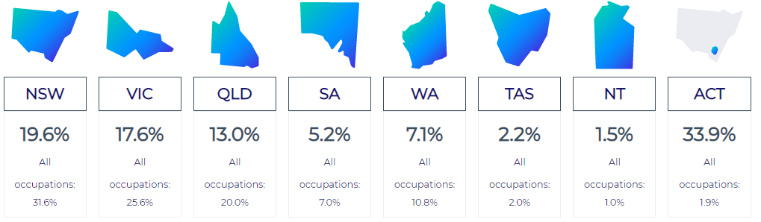
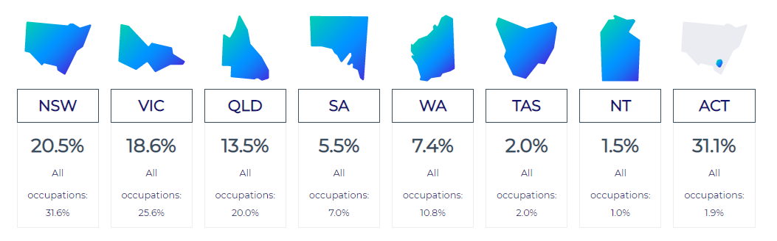
Appendix C: Labour Market Analysis
Policy Analyst
Intelligence and Policy Analyst
43
Source: National Skills Commission, Labour market insights - 2022

