Slide 1
NDIS Quality and Safeguards Commission
Roadshow presentation
March – April 2019

Slide 2
The NDIS – An Overview
Social insurance model guaranteeing support to eligible participants.
New way of providing disability services across Australia to people with significant and permanent disability. It funds the support needs of people between the ages of 0 to 65.
Takes a lifetime approach to the provision of services and supports so people with disability can live an ordinary life, achieve their goals and aspirations, and contribute to the social and economic life of the wider community.
Designed to maintain and enhance people’s informal supports, facilitate greater access to mainstream services and participate more fully in community life.
Supporting employment opportunities is also key and the economic benefits are predicated on many people living with disability and unpaid carers gaining employment.

Slide 3
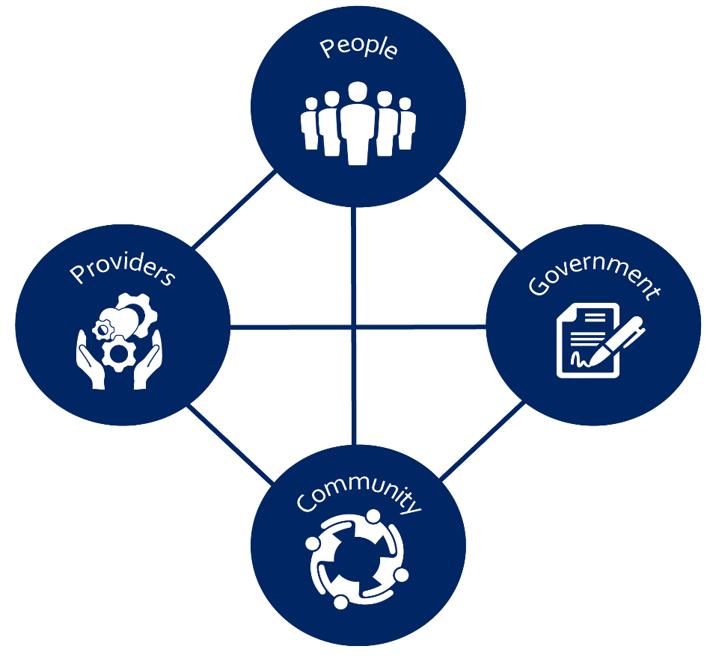
The NDIS – An Overview (continued)
The NDIS changes relationships – between people, providers, communities and government, to promote sustainable, long-term outcomes.
A Scheme based on insurance principles, about lifetime care and risk, through a market based approach, tackling some of our most complex social issues.
The NDIS changes the way government operates – as a provider, in markets, with the workforce, as a system steward.
Administrated by the NDIA, governed by a board and accountable to participating governments.
Quality of services and supports and safeguarding of participants is through a statutory, independent Commission.

Slide 4



Principles of the NDIS
Insurance approach
Choice and Control
Community and Mainstream
Supports economic and social participation
Funding for early intervention
Funding based on managing long-term costs across the lifetime of individuals
Shares the cost of disability support across the community
Participants determine how much control they want over their
supports and providers
Gives effect to obligations of the UN Convention on Rights of Persons with Disabilities
People supported to access community and funded supports
Does not duplicate or replace mainstream services
Works with mainstream and community supports

Slide 5

How is it different?
Before...
Under the NDIS...
People with disability access funded programs.
People are funded to select supports.
Funding to providers.
People choose how to manage your funding.
Supports and arrangements determined for people.
People choose what supports they most need and how they want them.
People are told who they will receive support from.
People choose where to get supports from.
Different Quality and Assurance Safeguards.
National NDIS Quality and Safeguards Framework based on consumer choice and protections.

Slide 6
How is quality and safeguarding different?
Nationally consistent approach to empower NDIS participants and set expectations for NDIS providers and their staff.
Underpinning foundations: UN Convention on the Rights of Persons with Disabilities; National Disability Strategy 2010-2020; National Disability Insurance Scheme Act 2013.
Three domains:
      Developmental: Building capability and support systems
      Preventative: Preventing harm and promoting quality
      Corrective: Responding if things go wrong.

Slide 7


About the NDIS Commission
Improve quality and safety of NDIS supports and services
Take over the registration of providers from the NDIA
Provide national consistency
Help providers to meet their obligations
Resolve problems and identify areas for improvement
Support continuous improvement and quality in the NDIS.

Slide 8
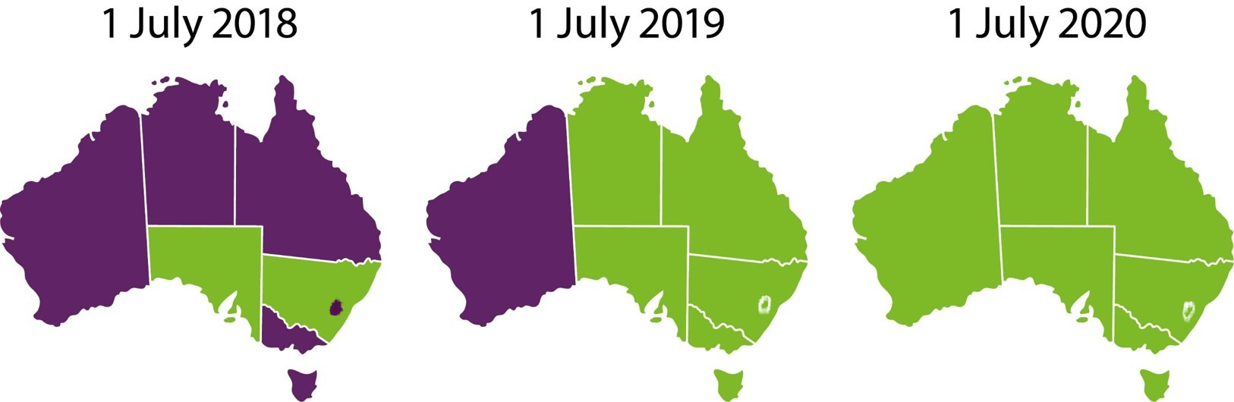
NDIS Commission roll-out

Slide 9

Our key functions
Registration and quality assurance
Code of Conduct
Worker screening
Reportable Incidents
Complaints
Behaviour Support
Information and capacity building
Compliance, investigations and enforcement.

Slide 10

Provider registration
Sets conditions of registration:
    Compliance with Commonwealth, state and territory laws
    Suitability to operate: entity and key personnel
    NDIS Code of Conduct
    Complaints management requirements
    NDIS Practice Standards
    Incident management and Reportable Incident requirements
    Behaviour Support requirements (if applicable)
    Worker screening.

Slide 11

Code of Conduct
Helps shape behaviour and culture of providers and workers
Applies to all providers (registered/unregistered) and workers
Anyone can complain to the NDIS Commission about a breach
The NDIS Commission monitors compliance and can take a range of actions in response to breaches.

Slide 12

Practice Standards Audit
All registered providers must be audited against relevant NDIS Practice Standards
Audits are proportionate to the size and scale of the organisation, risk and complexity of supports & services delivered
We’re approving and training more audit bodies
We’re here to help guide you through the process.

Slide 13

Complaints
    NDIS participants have the right to complain about the safety and quality of NDIS supports and services
    Every NDIS provider must have effective complaints management and
    resolution arrangements
The NDIS Commission will be responsible for handling complaints about NDIS providers
    All complaints will be taken seriously and assessed
    Some complaints will be appropriate for a facilitated resolution process
    Some complaints will require investigation
    Complaints and feedback are an opportunity for providers to improve service delivery.

Slide 14

Reportable Incidents
Providers must notify, investigate and respond to reportable incidents involving NDIS participants including:
    Death
    Serious injury
    Abuse and neglect
    Unlawful sexual or physical contact
    Sexual misconduct including grooming for sexual activity
    Unauthorised use of restrictive practices.
Reporting the incident to the NDIS Commission does not replace notifying any appropriate authorities, such as the police.

Slide 15

Behaviour Support
Positive Behaviour Support Capability Framework
Behaviour Support providers must lodge behaviour support plans with the NDIS Commission and notify it of the use of restrictive practices
Providers using restrictive practices must report monthly
Existing state legislation on restrictive practice
authorisations still apply.

Slide 16

Worker screening
New national worker screening system and database from 1 July 2019
It will replace existing arrangements and set a single, national standard for all workers
When in place, all registered NDIS providers must ensure
workers have a valid clearance
Workers will be subject to ongoing monitoring nationally.

Slide 17
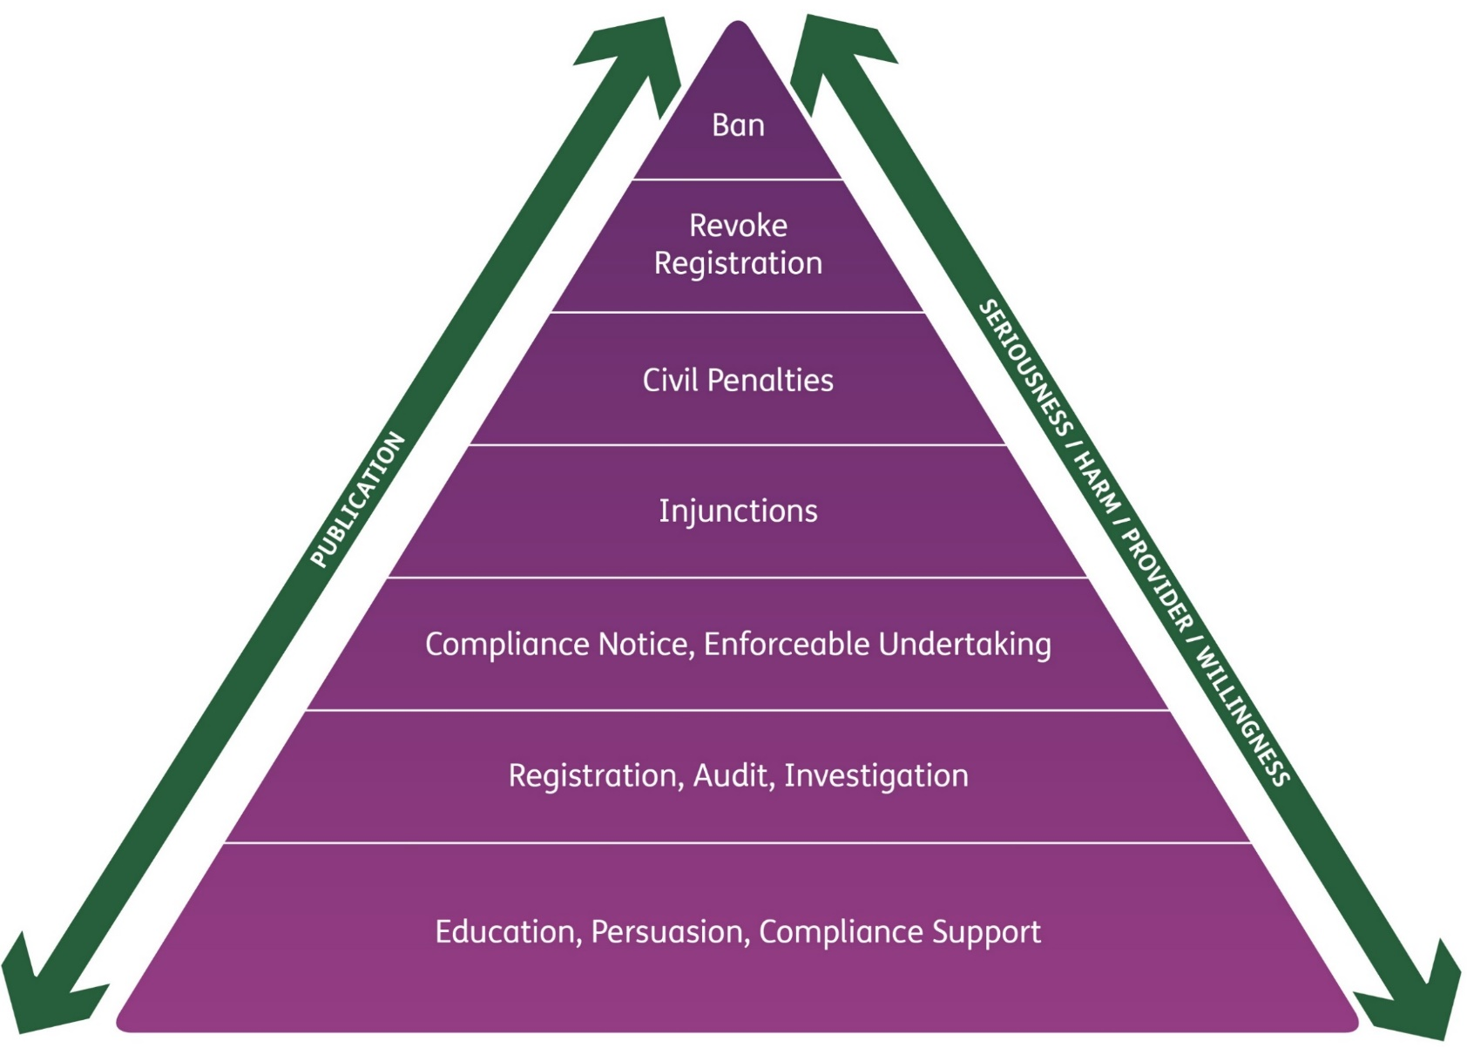
Investigative Powers and Enforcement Action

Slide 18
Support for transition
$17.6m Support for NDIS Providers Program - applications now open
To help NDIS providers deliver safe and high quality services/support
Focus on developing tools and resources for all NDIS providers including smaller providers, rural and remote Australia, areas with limited choices
Applications close on 29 April 2019 – visit the website for information.

Slide 19
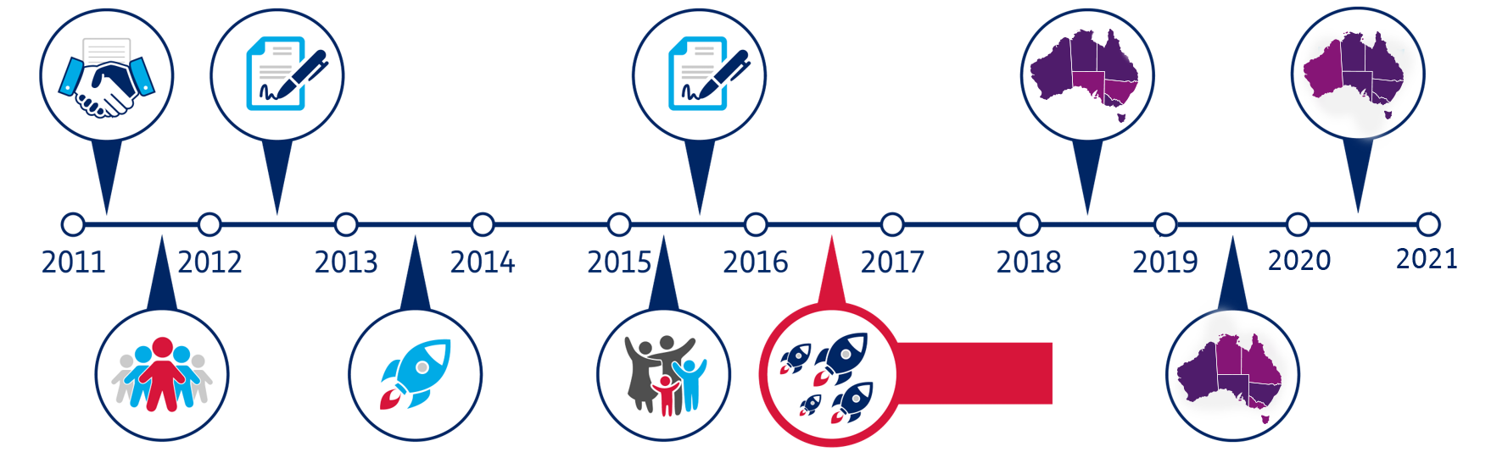
Implementing the NDIS – Where are we now?
Governments commit to the NDIS
Governments sign Heads of Agreement for full scheme
Governments sign NDIS Bilateral Agreements for transition
1 July 2018
NDIS & NDIS Commission rolled out in NSW and SA
1 July 2020
NDIS & NDIS Commission rolled-out in WA (National approach)
Full scheme rollout begins
Preparatory reforms to choice and control
Three-year NDIS trial launches commence
New trials
commences
Transition commences
1 July 2019
NDIS & NDIS Commission rolled out in NT, Qld, Vic, ACT and Tas

Slide 20

Progress update
We’re fully operational
Legislative frame and instruments in place
We’re continuing to talk to participants and providers
We’re keeping abreast of stakeholder concerns
We’re preparing for the 1 July 2019 transitions
We’re setting-up our state and territory offices.

Slide 21

How we will engage with providers
We are working with the NDIA, states and territories
Providers have received information from the NDIA on transition arrangements
Providers will receive several pieces of information
from the Commission in the lead-up to 1 July
More roadshows on specific topics coming in June.

Slide 22




Further Information
For more information visit:
www.ndiscommission.gov.au
Or contact: 1800 035 544
This is a free call from landlines
Follow us on LinkedIn

Slide 23
Questions?

