Slide 1
NDIS Quality and Safeguards Commission
Your Responsibilities – June roadshow
Samantha Taylor PSM

Slide 2
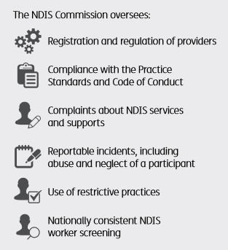


How do we work with providers?
We work with providers to improve the quality and safety of NDIS supports and services

Slide 3
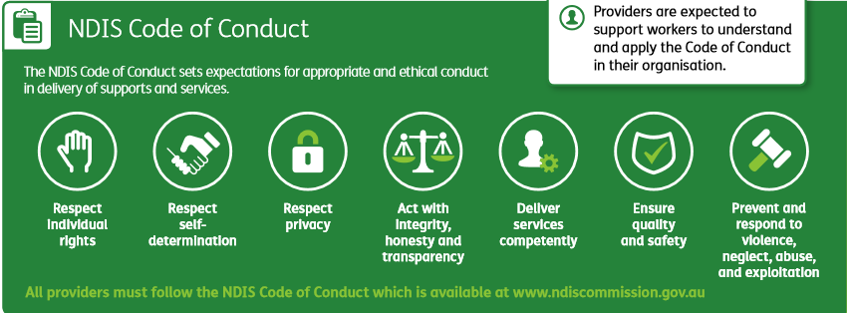
Code of conduct

Slide 4

Code: Worker Orientation Module
Worker Orientation Module
‘Quality Safety and You’
www.ndiscommission.gov.au/trainingcourse

Slide 5
Who needs to be registered?
Providers must be registered with the NDIS Commission if you deliver one or more of the following:
Services and supports to NDIS participants who have their plan managed by the NDIA
Specialist activities: SDA and Behaviour Support
Implement restrictive practices as part of the supports and services to participants
Providers delivering supports to people under the Commonwealth Continuity of Support program
There are benefits to providers in being registered

Slide 6
What does registration involve?
There are three components to registration:
assesses the provider and its key personnel for suitability to participate in the NDIS market, and
Independent assessment (audit) of against relevant NDIS Practice Standards, then
sets conditions of registration depending on what services and supports you are registering to provide

Slide 7

Provider registration
Conditions of registration:
    Compliance with Commonwealth, state and territory laws
    NDIS Practice Standards
    NDIS Code of Conduct
    Complaints management and resolution requirements
    Incident management and Reportable Incident requirements
    Behaviour Support requirements (if applicable)
    Worker screening.

Slide 8

What are the Practice Standards?
Requirements that set the standard of service you must deliver to be a registered NDIS provider
Benchmark for providers to assess performance and demonstrate high quality and safe supports for participants
Each Practice Standard is build from a high-level participant outcome, supported by quality indicators.

Slide 9
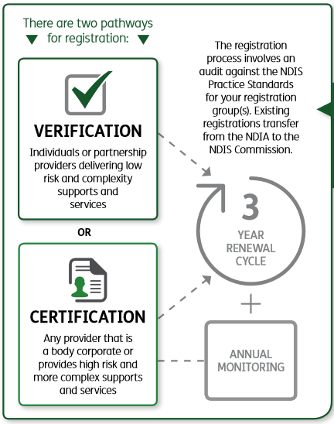

Practice Standards Audit

Slide 10

Practice Standards Audit - Verification
Baseline quality expectations of less complex supports and services for NDIS participants
Verification module includes:
Complaints management
Incident management
Risk management
Human resource management.
Plus:
General requirements including qualifications and experience

Slide 11
Practice Standards Audit - Certification
Baseline quality expectations of more complex supports and services for NDIS participants
Core module includes:
• Rights and Responsibilities
• Governance and Operational Management
• Provision of Supports, and
• Support Provision Environment.
Supplementary modules
(for more complex supports):
• High intensity daily personal activities
• Specialist behaviour support
• Implementing behaviour support plans
• Early childhood supports
• Specialised support coordination
• Specialised disability accommodation.

Slide 12

Core: Rights and responsibilities
Person centred supports
Individual values and beliefs respected
Privacy and dignity upheld
Independence and informed choice
[Free from] violence, abuse, neglect, exploitation and discrimination.

Slide 13

Person centred supports
Outcome: Each participant accesses supports that promote, uphold and respect their legal and human rights and is enabled to exercise informed choice and control. The provision of supports promotes, upholds and respects individual rights to freedom of expression, self-determination and decision-making.
To achieve this outcome, the following quality indicators should be demonstrated:
Each participant's legal and human rights are understood and incorporated into everyday practice.
Communication with each participant about the provision of supports is responsive to their needs and is provided in the language, mode of communication and terms that the participant is most likely to understand.
Each participant is supported to engage with their family, friends and chosen community as directed by the participant.

Slide 14

Worker screening
New national worker screening system and database coming
It will replace existing arrangements and set a single, national standard for all workers
When in place, all registered NDIS providers must ensure
workers have a valid clearance
Until in place, existing arrangements continue to apply
Workers will be subject to ongoing monitoring nationally.

Slide 15
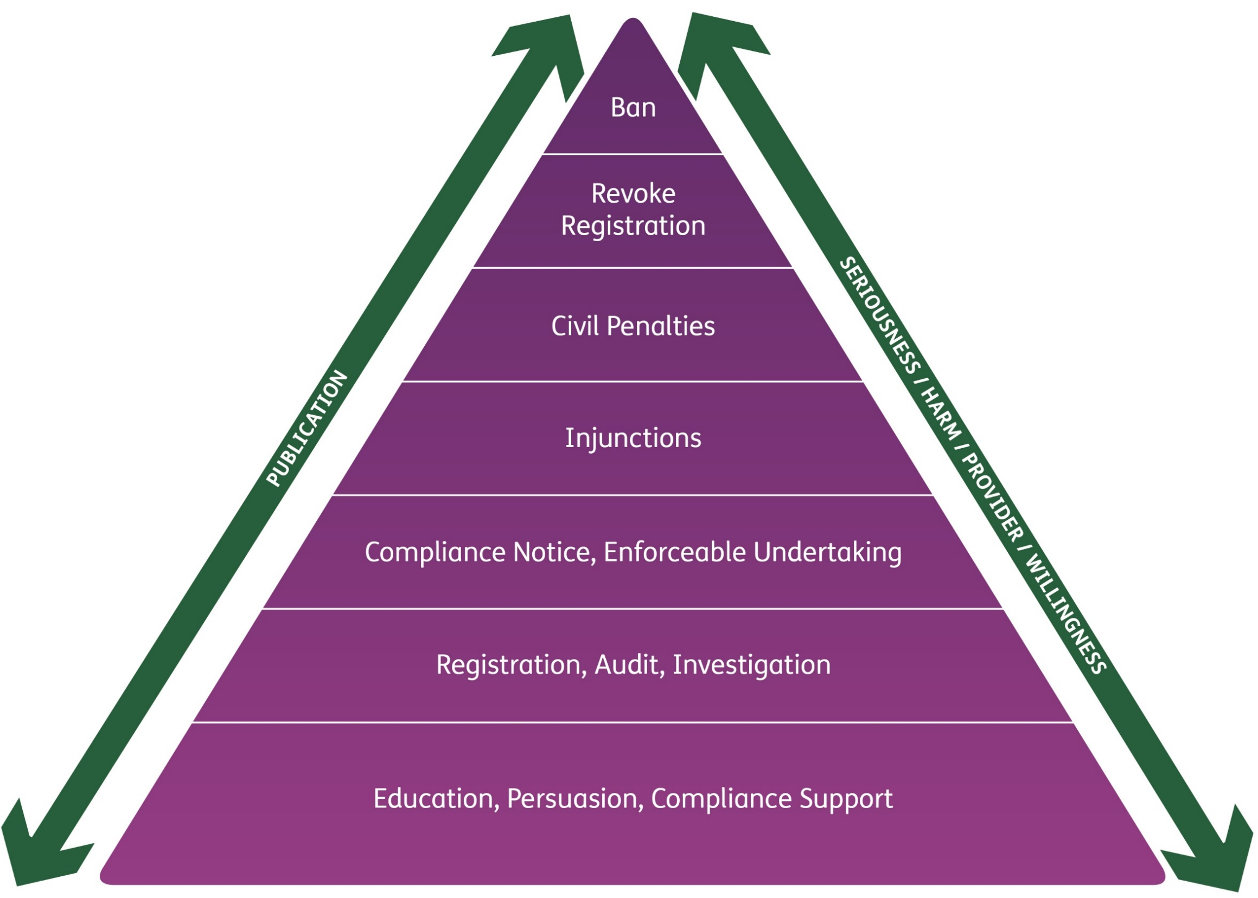
What happens when things don’t go well

Slide 16

How the NDIS Commission will support you
We are working with states and territories to build local relationships, and with the NDIA
Providers have received information from the NDIA on transition arrangements
We’ve sent you a series of resources/information
Visit our updated website
Contact us if you can’t find what you need.

Slide 17




Further Information
For more information visit:
www.ndiscommission.gov.au
Or contact: 1800 035 544
This is a free call from landlines
Follow us on LinkedIn and Facebook

Slide 18
Questions?

Slide 19
NDIS Quality and Safeguards Commission
Behaviour Support – June roadshow

Slide 20

Behaviour
Support

Slide 21

Regulated Restrictive Practices
    Restrictive practice: Any practice or intervention that has the effect of restricting the rights or freedom of movement of a person with disability (NDIS Act 2013 s9)
    Regulated restrictive practices [NDIS (Restrictive Practices and Behaviour Support) Rules 2018]:
      Seclusion
      Chemical restraint
      Mechanical restraint
      Physical restraint
      Environmental restraint.

Slide 22
Regulated Restrictive Practices
  Regulated restrictive practices can only be used in the context of:
  Reducing the risk of harm to the self or others
  Clearly being identified in a Behaviour Support Plan
  Authorisation (however described) by the State/Territory where required
  Only being used as a last resort
  Being the least restrictive response available
  Being proportionate to the potential harm to self or others
  Being used for the shortest possible time
  The NDIS participant being given opportunities to develop new skills that have the potential to avoid the need for a restrictive practice.

Slide 23

Behaviour Support – Our Role
Safeguarding the dignity of the person and improving their quality of life
Contemporary evidence-based practice
Constructively reducing behaviours that may lead to harm of self or others
Work towards the reduction and elimination of restrictive practices
Consider behaviour support practitioners suitable to deliver specialist behaviour support.

Slide 24

How we will reduce/eliminate restrictive practices
Building the capacity of Behaviour Support Practitioners
Developing policy and guidance materials
Education, training and advice to providers
Monitoring/analysing use of restrictive practices
Assisting states and territories in developing nationally consistent restrictive practice definitions and principles for authorisation.

Slide 25

Behaviour Support Provider Requirements
Providers must be registered for specialist behaviour support (or be a registered sole trader)
Specialist Behaviour Support Providers must engage an NDIS behaviour support practitioner to deliver services
Practitioners must be considered suitable as an NDIS behaviour support practitioner to undertake assessments and develop behaviour support plans
    Positive Behaviour Support Capability Framework
    “provisional suitability”.

Slide 26
Positive Behaviour Support Capability Framework
Core Practitioner
Proficient Practitioner
Advanced Practitioner
Specialist Practitioner

Slide 27
Interim Response
CPD & Supervision
Functional
Assessment
Assessment Resource Toolkit for the PBS Capability Framework
STEP 1
Practitioner self-assessment
Supervisor or provider validation
STEP 2
Practitioner and supervisor evidence
STEP 3
NDIS Commission
Verifies evidence
Determines suitability
Principles & Values
Reduce & Eliminate Restrictive Practice
Planning
Know it works
Implement

Slide 28

Developing a Behaviour Support Plan
For plans written after 1 July 2019 that include regulated restrictive practices,
the NDIS behaviour support practitioner must develop:
    An interim Behaviour Support Plan within 1 month
    A comprehensive Behaviour Support Plan within 6 months,
    including a functional behaviour assessment
Authorisation must be obtained using existing state or territory legislation
Interim and comprehensive behaviour support plans must be
lodged with the NDIS Commission.

Slide 29
Implementing Provider Requirements
    Providers must:
    Keep records on the use of restrictive practices
    Report monthly to the NDIS Commission on the use of regulated restrictive practices
    Obtain authorisation using existing state or territory legislation
    Comply with reportable incident requirements if using unauthorised restrictive practices
    Engage an NDIS behaviour support practitioner to develop behaviour support plans
    Work with a NDIS Behaviour Support practitioner to implement positive behaviour support strategies and monitor outcomes for the person with disability
    Support staff to receive appropriate training.

Slide 30


Further Information
For more information visit:
www.ndiscommission.gov.au
Or contact: 1800 035 544
This is a free call from landlines
Follow us on LinkedIn and Facebook

Slide 31
NDIS Quality and Safeguards Commission
Complaints and Reportable Incidents – June Roadshow

Slide 32
Complaints

Slide 33

Complaints
    NDIS participants have the right to complain or provide feedback about the safety and quality of NDIS supports and services
    NDIS providers must have effective complaints
    management and resolution arrangements in place
    Complaints and feedback are an opportunity for
    providers to improve service delivery.

Slide 34
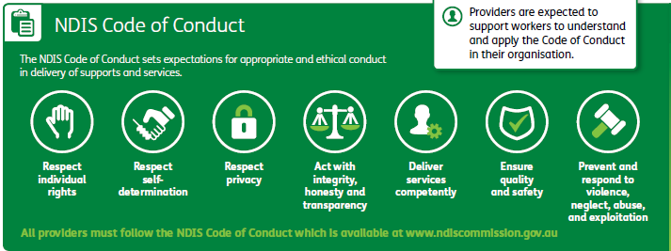
Code of Conduct

Slide 35
Who can make a complaint
Anyone can raise a complaint about the provision of supports and services by an NDIS provider, including:
    a person with disability who is receiving, or is eligible to receive, supports or services from an NDIS provider
    a worker employed or otherwise engaged by an NDIS provider (including volunteers)
    friends or family of a person with disability.

Slide 36

Complaints process
We aim to help resolve a complaint quickly where possible
The process may include:
Requests for documents
Actions for providers
Facilitated meetings

Slide 37
Reportable Incidents

Slide 38

Reportable Incidents
All registered providers must have an incident management system in place to records and manage incidents
Providers are required to notify us of reportable incidents that occur in connection with the delivery of NDIS supports and services
This does not replace existing obligations to report suspected crimes to the police and other relevant authorities.
    www.ndiscommission.gov.au/providers/reportable-incidents

Slide 39
What is a Reportable Incident?
A serious incident or allegation which results in harm to an NDIS participant and occurs in connection with NDIS supports and services, including:
the death of a person with a disability
serious injury of a person with a disability
abuse or neglect of a person with a disability
unlawful sexual or physical contact with, or assault of, a person with a disability
sexual misconduct committed against, or in the presence of, a person with a disability, including grooming of a person with a disability for sexual activity
the unauthorised use of a restrictive practice in relation to a person with a disability

Slide 40
Timeframe to report incidents
Most Reportable Incidents must be notified to us within 24 hours of a provider’s key personnel being made aware of it.
A more detailed report about the incident and actions taken in response to it must be provided within 5 business days.
The unauthorised use of restrictive practice must be notified to us within 5 business days of a provider’s key personnel being made aware of it.
If there is harm to a participant, it must be reported within 24 hours.

Slide 41
Action we can take
If a Reportable Incident raises a serious compliance issue, we have powers to take action, which may include:
requiring the provider to undertake specified remedial action
carrying out an internal investigation about the incident
engaging an independent expert to investigate and report on the incident
give information to police or refer to another body e.g. child protection authorities.

Slide 42
How to report an incident
To report an incident:
www.ndiscommission.gov.au/providers/reportable-incidents

Slide 43

Further Information
For more information visit:
www.ndiscommission.gov.au
Or contact: 1800 035 544
This is a free call from landlines
Follow us on LinkedIn and Facebook

Slide 44
Questions?

